Slide 1
CSE 4905 Authentication

Slide 2
Authentication
Authentication is a mechanism for determining some principal’s identity
Usually used to bootstrap authorization
Authorization is a mechanism for determining privilege based on identity
Any authorization system is only as secure as the accompanying authentication system

Slide 3
Authentication through PKI
Covered PKI last class, certificates are mechanism for verifying identity
Can be augmented to full authentication protocol
Need to verify:
Correct/consistent certificate
Connecting client can sign messages at their connection time (possession of private key)
This is how we authenticate web servers every day, why don’t we do this with clients?

Slide 4
Exercise
Certificates and PKI are ubiquitous method of identifying servers on the web
Almost no clients use this method
Make your best guess as to why
Consider psychological, economic, security, usability, historical factors
“The Quest to Replace Passwords” by Bonneau et al.

Slide 5
Some factors
Historical
PKI was invented after computers were deployed
Cryptography wasn’t widely available when the web started
Psych:
Users don’t want static identity
Users often want anonymous actions online
Economic
Cryptography slows response time, reducing sales
Client configuration may be difficult reducing sales
Clients have little incentive to register certificate (server benefits)
Usable:
Multiple devices (don’t want to sync certificates)
Users don’t want to create identity
Many more clients than servers (PKI becomes more of a mess)

Slide 6
Authenticating on the web
Two main methods of web authentication
Passwords
Cookies
Some variety recently (phone, hardware approaches)

Slide 7
Passwords

Slide 8
Web and HTTP
First, a review…
web page consists of objects
object can be HTML file, JPEG image, Java applet, audio file, PHP script, …
web page consists of base HTML-file which includes several referenced objects
each object is addressable by a URL, e.g.,
www.someschool.edu/someDept/pic.gif
host name
path name

Slide 9
HTTP (hypertext transfer protocol)
Web’s application layer protocol
client/server model
client: browser that requests, receives, (using HTTP protocol) and “displays” Web objects
server: Web server sends (using HTTP protocol) objects in response to requests
HTTP request
PC running
Firefox browser
HTTP response
HTTP request
server
running
Apache Web
server
HTTP response
iPhone running
Safari browser

Slide 10
Example: logging into HuskyCT
<!DOCTYPE html PUBLIC "-//W3C//DTD XHTML 1.0 Strict//EN" "http://www.w3.org/TR/xhtml1/DTD/xhtml1-strict.dtd">
<html xmlns="http://www.w3.org/1999/xhtml" lang="en">
<head>
<title>University of Connecticut NetID Single Sign On</title>
<link type="text/css" rel="stylesheet" href="themes/uconn/cas.css" />
<meta http-equiv="X-UA-Compatible" content="IE=edge" />
<meta http-equiv="Content-Type" content="text/html; charset=UTF-8" />
<meta name="description" content="UConn Single Sign On serves as your login to many University computing and networking services.">
<meta name="viewport" content="width=device-width, initial-scale=1, maximum-scale=1">
<link type="text/css" rel="stylesheet" href="themes/uconn/cas.css" />
<link rel="icon" href="/cas/favicon.ico" type="image/x-icon" />
</head>
<!--[if lt IE 7]> <body class="ie lte9 lte8 lte7 lte6"> <![endif]-->
<!--[if IE 7]> <body class="ie ie7 lte9 lte8 lte7"> <![endif]-->
<!--[if IE 8]> <body class="ie ie8 lte9 lte8"> <![endif]-->
<!--[if IE 9]> <body class="ie ie9 lte9"> <![endif]-->
<!--[if gt IE 9]> <!-->
<body>
<!--> <![endif]-->
<a href="#loginskip" class="accessibility">Skip to Login</a>
<div id="main">
<div id="uc-header">
<div class="container">
<h1 id="uc-identity"> <span id="uc-logo" title="University of Connecticut"> <a href="http://uconn.edu"> <svg version="1.1" class="uc-header-svg" id="uc-logo-svg" xmlns="http://www.w3.org/2000/svg" xmlns:xlink="http://www.w3.org/1999/xlink" x="0px" y="0px" width="102.296px" height="20.97px" viewBox="0 0 102.296 20.97" enable-background="new 0 0 102.296 20.97" xml:space="preserve">
<g>
<path d="M0,18.744V0.564h4.423v15.962c1.979,0.593,3.459,0.895,4.438,0.906c0.969,0,2.443-0.302,4.423-0.906V0.564h4.423v18.18c-2.601,1.503-5.549,2.255-8.846,2.255C5.558,20.999,2.604,20.247,0,18.744z"></path>
<path d="M21.348,18.756V2.26c2.559-1.496,5.5-2.25,8.821-2.26c3.343,0,6.294,0.753,8.853,2.26v5.149H34.6V4.47c-1.367-0.42-2.841-0.629-4.422-0.629c-1.561,0-3.03,0.21-4.407,0.629v12.026c1.366,0.419,2.835,0.628,4.407,0.628c1.582,0,3.056-0.209,4.422-0.628v-3.763h4.422v6.021c-2.577,1.474-5.525,2.211-8.844,2.211C26.873,20.967,23.931,20.23,21.348,18.756z"></path>
<path d="M42.474,18.756V2.227C45.054,0.753,48.006,0.01,51.327,0c3.323,0,6.273,0.742,8.854,2.228v16.528c-2.578,1.475-5.526,2.211-8.846,2.211C48.011,20.967,45.057,20.23,42.474,18.756z M46.897,16.497c1.411,0.419,2.889,0.628,4.439,0.628c1.538,0,3.012-0.209,4.422-0.628V4.47c-1.388-0.42-2.863-0.629-4.422-0.629c-1.571,0-3.051,0.21-4.439,0.629V16.497L46.897,16.497z"></path>
<path d="M63.408,0.44h4.729l8.796,14.059h0.097V0.44h4.036v19.805h-4.729L67.541,6.202h-0.13v14.043h-4.002L63.408,0.44L63.408,0.44z"></path>
<path d="M84.47,0.44h4.729l8.797,14.059h0.097V0.44h4.036v19.805h-4.729L88.602,6.202h-0.129v14.043H84.47V0.44L84.47,0.44z"></path>
</g>
</svg> <span class="uc-header-fallback" id="uc-logo-fallback"> <img src="images/uconn.png" alt="UCONN"> </span> </a> </span>
<span id="uc-title"> <a href="http://uconn.edu"> <span id="uc-title-universityof"> <svg version="1.1" id="uc-title-universityof-svg" class="uc-sub-svg" xmlns="http://www.w3.org/2000/svg" xmlns:xlink="http://www.w3.org/1999/xlink" x="0px" y="0px" width="145.24px" height="12.883px" viewBox="0 0 145.24 12.883" enable-background="new 0 0 145.24 12.883" xml:space="preserve">
<g>
<path d="M3.513,9.631c0.468,0.583,1.099,0.874,1.892,0.874s1.42-0.292,1.884-0.874C7.75,9.048,7.981,8.252,7.981,7.243V0.289h2.812v7.044c0,1.827-0.504,3.229-1.515,4.208c-1.009,0.979-2.301,1.469-3.874,1.469s-2.867-0.493-3.883-1.478C0.507,10.546,0,9.148,0,7.333V0.289h2.811v6.955C2.811,8.252,3.045,9.048,3.513,9.631z"></path>
<path d="M23.008,0.289h2.811v12.594h-2.811l-5.999-7.892v7.892h-2.812V0.289h2.63l6.18,8.107V0.289z"></path>
<path d="M29.404,0.289h2.812v12.594h-2.812V0.289z"></path>
<path d="M40.45,8.306l3.208-8.018h3.044l-5.063,12.594H39.26L34.197,0.289h3.044L40.45,8.306z"></path>
<path d="M57.764,0.289v2.504h-6.27v2.595h5.639v2.396h-5.639v2.612h6.468v2.486h-9.28V0.289H57.764z"></path>
<path d="M71.169,4.468c0,2.019-0.799,3.322-2.396,3.91l3.188,4.504h-3.459L65.71,8.865h-1.945v4.018h-2.812V0.289h4.776c1.957,0,3.354,0.33,4.188,0.991C70.752,1.94,71.169,3.002,71.169,4.468z M67.782,5.964c0.348-0.312,0.522-0.808,0.522-1.487c0-0.679-0.181-1.144-0.541-1.396c-0.36-0.252-0.99-0.378-1.892-0.378h-2.107v3.729h2.054C66.78,6.432,67.434,6.277,67.782,5.964z"></path>
<path d="M77.485,2.802c-0.271,0.223-0.406,0.517-0.406,0.882c0,0.367,0.166,0.658,0.496,0.874c0.331,0.217,1.093,0.472,2.289,0.767c1.195,0.294,2.123,0.736,2.784,1.325c0.66,0.588,0.99,1.446,0.99,2.576c0,1.129-0.423,2.045-1.27,2.748c-0.847,0.703-1.961,1.054-3.342,1.054c-1.994,0-3.79-0.738-5.388-2.216l1.676-2.054c1.356,1.19,2.612,1.784,3.765,1.784c0.516,0,0.922-0.111,1.216-0.333c0.294-0.221,0.441-0.522,0.441-0.901c0-0.378-0.156-0.678-0.468-0.9c-0.312-0.223-0.932-0.448-1.856-0.676c-1.465-0.348-2.538-0.801-3.216-1.36c-0.678-0.559-1.018-1.435-1.018-2.631c0-1.195,0.429-2.117,1.288-2.766C76.326,0.325,77.398,0,78.684,0c0.84,0,1.682,0.145,2.522,0.432c0.84,0.288,1.574,0.697,2.198,1.226l-1.423,2.054c-1.094-0.829-2.223-1.244-3.388-1.244C78.125,2.468,77.755,2.58,77.485,2.802z"></path>
<path d="M86.521,0.289h2.811v12.594h-2.811V0.289z"></path>
<path d="M98.25,2.721v10.162h-2.811V2.721h-3.568V0.289h9.947v2.432H98.25z"></path>
<path d="M109.781,12.883h-2.811V7.91l-4.36-7.622h3.045l2.72,4.685l2.722-4.685h3.045l-4.361,7.622V12.883z"></path>
<path d="M131.817,11.144c-1.273,1.244-2.84,1.866-4.703,1.866c-1.861,0-3.429-0.622-4.702-1.866c-1.274-1.242-1.91-2.789-1.91-4.639c0-1.85,0.636-3.397,1.91-4.64C123.685,0.622,125.252,0,127.114,0c1.863,0,3.43,0.622,4.703,1.865c1.274,1.243,1.91,2.79,1.91,4.64C133.727,8.355,133.091,9.901,131.817,11.144z M130.862,6.514c0-1.124-0.359-2.082-1.081-2.874c-0.721-0.793-1.606-1.189-2.657-1.189c-1.052,0-1.937,0.396-2.657,1.189c-0.721,0.792-1.082,1.75-1.082,2.874c0,1.123,0.36,2.078,1.082,2.865c0.72,0.787,1.605,1.179,2.657,1.179c1.051,0,1.937-0.393,2.657-1.179C130.502,8.592,130.862,7.637,130.862,6.514z"></path>
<path d="M145.24,0.289v2.468h-5.837v2.721h5.549v2.469h-5.549v4.937h-2.812V0.289H145.24z"></path>
</g>
</svg> <span class="uc-header-fallback" id="uc-title-universityof-fallback"> <img src="images/university-of.png" alt="University of"> </span> </span> <span id="uc-title-connecticut"> <svg version="1.1" id="uc-title-connecticut-svg" class="uc-sub-svg" xmlns="http://www.w3.org/2000/svg" xmlns:xlink="http://www.w3.org/1999/xlink" x="0px" y="0px" width="139.551px" height="12.979px" viewBox="0 0 139.551 12.979" enable-background="new 0 0 139.551 12.979" xml:space="preserve">
<g>
<path d="M6.505,10.34c1.374,0,2.496-0.544,3.368-1.631l1.792,1.845c-1.421,1.602-3.098,2.401-5.026,2.401
c-1.93,0-3.519-0.608-4.767-1.828C0.624,9.908,0,8.373,0,6.514c0-1.857,0.636-3.408,1.908-4.65C3.181,0.621,4.736,0,6.577,0
c2.054,0,3.774,0.783,5.161,2.348L9.999,4.318C9.115,3.22,8.016,2.669,6.702,2.669c-1.052,0-1.951,0.344-2.697,1.031
c-0.748,0.688-1.12,1.612-1.12,2.777s0.352,2.101,1.057,2.805C4.647,9.986,5.501,10.34,6.505,10.34z"></path>
<path d="M24.62,11.083c-1.266,1.236-2.825,1.854-4.677,1.854c-1.851,0-3.411-0.618-4.676-1.854
c-1.267-1.237-1.9-2.773-1.9-4.614c0-1.839,0.633-3.377,1.9-4.614C16.532,0.618,18.092,0,19.943,0c1.852,0,3.412,0.618,4.677,1.855
c1.267,1.236,1.899,2.774,1.899,4.614C26.52,8.31,25.887,9.846,24.62,11.083z M23.67,6.478c0-1.117-0.358-2.07-1.075-2.858
c-0.717-0.789-1.598-1.183-2.643-1.183c-1.046,0-1.927,0.394-2.644,1.183c-0.716,0.788-1.075,1.741-1.075,2.858
s0.359,2.066,1.075,2.85c0.717,0.783,1.598,1.172,2.644,1.172c1.045,0,1.926-0.389,2.643-1.172
C23.312,8.543,23.67,7.595,23.67,6.478z"></path>
<path d="M38.131,0.287h2.796v12.526h-2.796l-5.966-7.849v7.849h-2.796V0.287h2.616l6.146,8.062V0.287z"></path>
<path d="M53.254,0.287h2.796v12.526h-2.796l-5.966-7.849v7.849h-2.796V0.287h2.616l6.146,8.062V0.287z"></path>
<path d="M68.646,0.287v2.491h-6.235v2.58h5.608v2.384h-5.608v2.598h6.433v2.473h-9.229V0.287H68.646z"></path>
<path d="M77.569,10.34c1.375,0,2.497-0.544,3.37-1.631l1.791,1.845c-1.419,1.602-3.096,2.401-5.024,2.401
c-1.931,0-3.519-0.608-4.767-1.828c-1.249-1.219-1.873-2.755-1.873-4.614c0-1.857,0.636-3.408,1.907-4.65
C74.246,0.621,75.802,0,77.643,0c2.054,0,3.772,0.783,5.161,2.348l-1.738,1.971c-0.885-1.099-1.983-1.649-3.297-1.649
c-1.052,0-1.952,0.344-2.697,1.031c-0.749,0.688-1.12,1.612-1.12,2.777s0.352,2.101,1.056,2.805
C75.712,9.986,76.565,10.34,77.569,10.34z"></path>
<path d="M90.723,2.706v10.107h-2.794V2.706h-3.55V0.287h9.893v2.419H90.723z"></path>
<path d="M96.796,0.287h2.796v12.526h-2.796V0.287z"></path>
<path d="M108.91,10.34c1.375,0,2.497-0.544,3.37-1.631l1.791,1.845c-1.422,1.602-3.098,2.401-5.026,2.401
s-3.519-0.608-4.768-1.828s-1.871-2.755-1.871-4.614c0-1.857,0.634-3.408,1.908-4.65C105.587,0.621,107.142,0,108.981,0
c2.054,0,3.774,0.783,5.161,2.348l-1.738,1.971c-0.883-1.099-1.983-1.649-3.298-1.649c-1.05,0-1.95,0.344-2.694,1.031
c-0.749,0.688-1.12,1.612-1.12,2.777s0.35,2.101,1.056,2.805C107.053,9.986,107.906,10.34,108.91,10.34z"></path>
<path d="M120.072,9.578c0.467,0.58,1.093,0.869,1.882,0.869c0.789,0,1.412-0.29,1.874-0.869
c0.459-0.579,0.688-1.371,0.688-2.374V0.287h2.796v7.007c0,1.815-0.501,3.21-1.505,4.184c-1.003,0.975-2.289,1.46-3.854,1.46
c-1.563,0-2.851-0.49-3.862-1.47c-1.009-0.98-1.513-2.37-1.513-4.174V0.287h2.794v6.917C119.374,8.207,119.607,8.999,120.072,9.578
z"></path>
<path d="M136.004,2.706v10.107h-2.796V2.706h-3.548V0.287h9.891v2.419H136.004z"></path>
</g>
</svg> <span class="uc-header-fallback" id="uc-title-connecticut-fallback"> <img src="images/connecticut.png" alt="Connecticut"> </span> </span> </a> </span>
</h1>
<div id="uc-utility">
<ul id="uc-utility-list">
<li class="uc-utility-item"> <span> <a href="
http://uconn.edu/search.php" class="uc-utility-btn" id="uc-search"> <span id="uc-search-button"> <span id="uc-utility-btn-svg"> <svg version="1.1" id="uc-utility-btn-search-svg" xmlns="http://www.w3.org/2000/svg" xmlns:xlink="http://www.w3.org/1999/xlink" x="0px" y="0px" width="17.267px" height="17.033px" viewBox="0 0 17.267 17.033" enable-background="new 0 0 17.267 17.033" xml:space="preserve">
<path d="M17.267,14.742l-5.323-5.324c0.441-0.857,0.695-1.828,0.695-2.859c0-3.451-2.798-6.25-6.25-6.25
s-6.25,2.799-6.25,6.25c0,3.453,2.798,6.25,6.25,6.25c1.213,0,2.341-0.35,3.3-0.949l5.229,5.23L17.267,14.742z M2.806,6.559
c0-1.979,1.604-3.582,3.583-3.582S9.973,4.58,9.973,6.559c0,1.98-1.604,3.584-3.583,3.584S2.806,8.539,2.806,6.559z"></path>
</svg> </span> <span id="uc-utility-btn-fallback"> <img src="images/search-icon.png" alt="search icon"> </span> </span> </a> </span> </li>
<li class="uc-utility-item"> <a href="http://uconn.edu/azindex.php" class="uc-utility-btn" id="uc-utility-btn-az"> <svg version="1.1" id="uc-utility-btn-az-svg" xmlns="http://www.w3.org/2000/svg" xmlns:xlink="http://www.w3.org/1999/xlink" x="0px" y="0px" width="19.7px" height="8.618px" viewBox="0 0 19.7 8.618" enable-background="new 0 0 19.7 8.618" xml:space="preserve">
<path d="M3.282-0.016h2.042L8.38,8.62H6.423l-0.57-1.775H2.672L2.087,8.62H0.199L3.282-0.016z M3.163,5.357h2.212
L4.284,1.959L3.163,5.357z"></path>
<path d="M8.84,3.384h3.268v1.582H8.84V3.384z"></path>
<path d="M12.864,7.096l4.418-5.582h-4.307v-1.529h6.549v1.447l-4.477,5.664h4.488V8.62h-6.672V7.096z"></path>
</svg> <span id="uc-utility-btn-az-fallback">A-Z</span> </a> </li>
</ul>
</div>
</div>
</div>
<div id="wrap">
<div id="focus">
<h2 id="system">NetID Single Sign On</h2>
<form id="credentials" action="/cas/login?service=https%3A%2F%2Flms.uconn.edu%2Fwebapps%2Fbb-auth-provider-cas-BB5849b9bae4172%2Fexecute%2FcasLogin%3Fcmd%3Dlogin%26authProviderId%3D_102_1%26redirectUrl%3Dhttps%253A%252F%252Flms.uconn.edu%252Fwebapps%252Fportal%252Fexecute%252FdefaultTab%26globalLogoutEnabled%3Dtrue" method="post">
<fieldset>
<label for="username">NetID</label>
<input id="username" name="username" class="textfield" tabindex="1" placeholder="NetID" accesskey="n" type="text" value="" autocomplete="off"/>
<label for="password">Password</label>
<input id="password" name="password" class="textfield" tabindex="2" placeholder="Password" accesskey="p" type="password" value="" size="18" autocomplete="off"/>
<p id="message">On your way to... <span id="destination"></span></p>
<input type="hidden" name="lt" value="LT-6070518-ltGPkgfFvnJfVWsRGZdGzoanSF6WsS" />
<input type="hidden" name="execution" value="e2s1" />
<input type="hidden" name="_eventId" value="submit" />
<input id="button" name="submit" accesskey="l" value="Login" tabindex="4" type="submit">
<p id="slogan"><strong>UConn Single Sign On</strong> serves as your login to many University computing and networking services.</p>
<div class="row_check">
<input id="warn" name="warn" value="true" type="checkbox" />
<span id="warn_label">Warn me before logging me into other sites.</span>
</div>
</fieldset>
</form>
<script>
var uri = encodeURIComponent(window.location.href);
uri = uri.split("%3F");
if (uri[1])
{
uri = (((((((uri[1]).replace('service%3D','')).replace('http%253A%252F%252F','')).replace('https%253A%252F%252F','')).replace('TARGET%3D','')).replace('https%253a%252f%252f','')).replace('http%253a%252f%252f','')).replace('https%3a%2f%2f','');
uri = (uri.split("%252F"))[0];
uri = (uri.split("%252"))[0];
}
else
{
uri = (uri[0].replace('https%3A%2F%2F','')).replace('%2Fcas%2Flogin','');
uri = (uri.split("%3B"))[0];
}
document.getElementById('destination').innerHTML = uri;
</script>
<p id="help"><a href="http://netid.uconn.edu">Need Help?</a></p>
</div>
</div>
<div id="uc-footer">
<ul>
<li><a href="http://uconn.edu">&copy; University of Connecticut</a></li>
<li><a href="http://uconn.edu/disclaimers-and-copyrights.php">Disclaimers, Privacy &amp; Copyright</a> </li>
<li><a href="http://uits.uconn.edu/?page_id=943">Help</a> </li>
</ul>
</div>
<script type="text/javascript" src="js/modernizr.js"></script>
<script type="text/javascript" src="js/login.js"></script>
</div>
</body>
</html>
<label for="username">NetID</label>
<input id="username" name="username" class="textfield" tabindex="1" placeholder="NetID" accesskey="n" type="text" value="" autocomplete="off"/>
<label for="password">Password</label>
<input id="password" name="password" class="textfield" tabindex="2" placeholder="Password" accesskey="p" type="password" value="" size="18" autocomplete="off"/>
<p id="message">On your way to... <span id="destination"></span></p>
<input type="hidden" name="lt" value="LT-6070518-ltGPkgfFvnJfVWsRGZdGzoanSF6WsS" />
<input type="hidden" name="execution" value="e2s1" />
<input type="hidden" name="_eventId" value="submit" />
<input id="button" name="submit" accesskey="l" value="Login" tabindex="4" type="submit">
<p id="slogan"><strong>UConn Single Sign On</strong> serves as your login to many University computing and networking services.</p>
<div class="row_check">
<input id="warn" name="warn" value="true" type="checkbox" />
<span id="warn_label">Warn me before logging me into other sites.</span>
</div>
</fieldset>

Slide 11
Example: logging into HuskyCT
<label for="username">NetID</label>
<input id="username" name="username" class="textfield" tabindex="1" placeholder="NetID" accesskey="n" type="text" value="" autocomplete="off"/>
<label for="password">Password</label>
<input id="password" name="password" class="textfield" tabindex="2" placeholder="Password" accesskey="p" type="password" value="" size="18" autocomplete="off"/>
<p id="message">On your way to... <span id="destination"></span></p>
<input type="hidden" name="lt" value="LT-6070518-ltGPkgfFvnJfVWsRGZdGzoanSF6WsS" />
<input type="hidden" name="execution" value="e2s1" />
<input type="hidden" name="_eventId" value="submit" />
<input id="button" name="submit" accesskey="l" value="Login" tabindex="4" type="submit">
<p id="slogan"><strong>UConn Single Sign On</strong> serves as your login to many University computing and networking services.</p>
<div class="row_check">
<input id="warn" name="warn" value="true" type="checkbox" />
<span id="warn_label">Warn me before logging me into other sites.</span>
</div>
</fieldset>

Slide 12
Example: logging into HuskyCT
You submit a password
The server compares this to the stored password value (maintaining a database of all users and their passwords)
If your submitted password matches you are authenticated
Given the appropriate permissions
Why is this a bad idea?

Slide 13
Example: logging into HuskyCT

Slide 14
Password Compromises
Password compromises are a major problem
Most users don’t use unrelated (or distinct) passwords on different sites
Hack on one site leads to compromise on others
What cryptographic tool could we use to mitigate this problem?
symmetric/asymmetric encryption, digital signatures, MAC, hash?

Slide 15
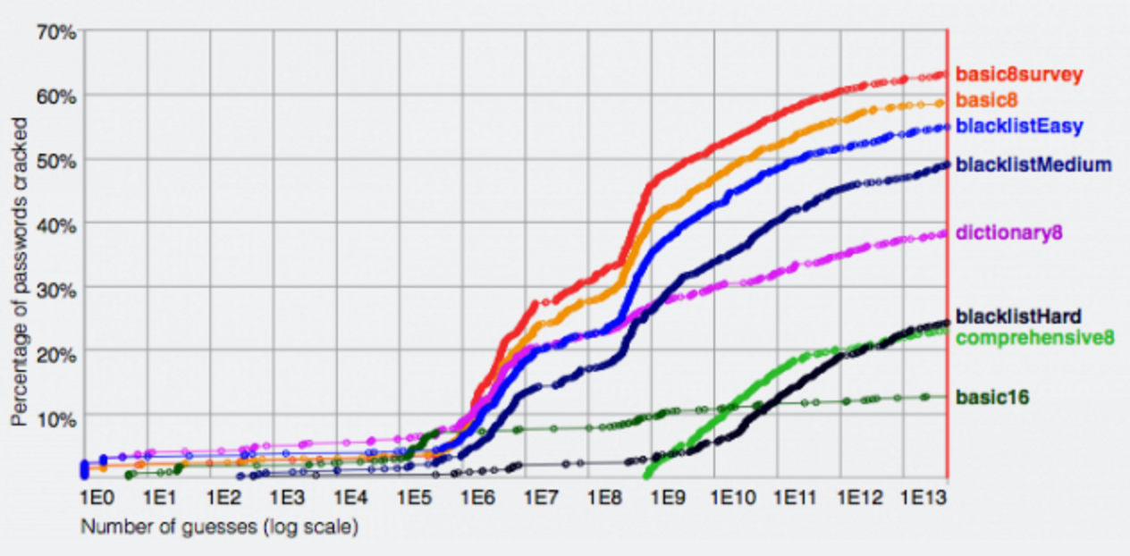
Password hashing
Most servers keep H(password) instead of the password
H is a collision resistant hash function (such as SHA256)
Ideally, a hash of a password shouldn’t reveal much information, however it does allow an attacker to guess a password and know if they are right
Over half of UK adults use the same password to access internet sites
One in four use birthdays or names as passwords

Slide 16
Password cracking
Process of hash many passwords to try and determined stored password
Performed on GPUs
Best machines can try 2³⁸ passwords/sec
Most user passwords are easily guessable by determined attacker

Slide 17
Salting
Defensive technique where each hash is randomized
Prevents same password from mapping to same hash (within one server and across servers)
Prevents precomputation attacks (using rainbow tables)

Slide 18
Peppering
Add private cryptographic key to hash computation
Store cryptographic key in web application (often separate from backend database), use same key for all passwords
Forces adversary compromise of web application and database

Slide 19
HTTP request message
two types of HTTP messages: request, response
HTTP request message:
ASCII (human-readable format)
carriage return character
request line
(GET, POST,
HEAD commands)
line-feed character
GET /index.html HTTP/1.1\r\n
Host: www-net.cs.umass.edu\r\n
User-Agent: Firefox/3.6.10\r\n
Accept: text/html,application/xhtml+xml\r\n
Accept-Language: en-us,en;q=0.5\r\n
Accept-Encoding: gzip,deflate\r\n
Accept-Charset: ISO-8859-1,utf-8;q=0.7\r\n
Keep-Alive: 115\r\n
Connection: keep-alive\r\n
\r\n
header
lines
carriage return,
line feed at start
of line indicates
end of header lines

Slide 20
HTTP response message
status line
(protocol
status code
status phrase)
HTTP/1.1 200 OK\r\n
Date: Sun, 26 Sep 2010 20:09:20 GMT\r\n
Server: Apache/2.0.52 (CentOS)\r\n
Last-Modified: Tue, 30 Oct 2007 17:00:02 GMT\r\n
ETag: "17dc6-a5c-bf716880"\r\n
Accept-Ranges: bytes\r\n
Content-Length: 2652\r\n
Keep-Alive: timeout=10, max=100\r\n
Connection: Keep-Alive\r\n
Content-Type: text/html; charset=ISO-8859-1\r\n
\r\n
data data data data data ...
header
lines
data, e.g.,
requested
HTML file

Slide 21
HTTP: how to maintain states?
HTTP is stateless
Every request is treated independently
Why? maintaining state is hard
But often need to maintain states
authentication
customization
shopping carts
recommendations
…

Slide 22
Cookies
No one wants to enter their password every time they submit an HTTP form

Slide 23
HTTP: how to maintain states?
HTTP is stateless
Every request is treated independently
Why? maintaining state is hard
But often need to maintain states
authentication
customization
shopping carts
recommendations
…
Solution: HTTP cookies

Slide 24
HTTP cookies
example:
Susan always access Internet from PC
visits specific e-commerce site for first time
when initial HTTP requests arrives at site, site creates:
unique ID
entry in backend database for ID

Slide 25
Cookies: keeping “state”
client
server
ebay 8734
usual http request msg
Amazon server
creates ID
1678 for user
cookie file
usual http response
set-cookie: 1678
backend
database
create
entry
ebay 8734
amazon 1678
usual http request msg
cookie: 1678
cookie-
specific
action
access
usual http response msg
one week later:
access
ebay 8734
amazon 1678
usual http request msg
cookie: 1678
cookie-
specific
action
usual http response msg

Slide 26
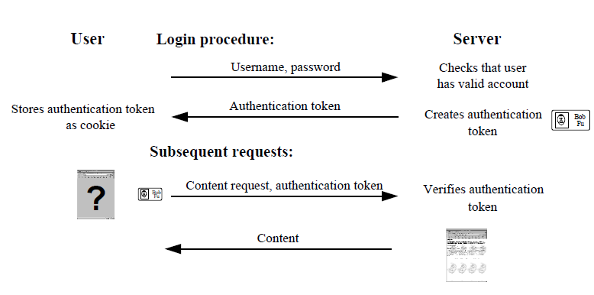
Cookies for authentication

Slide 27
Cookie specifics
Name
Value
expiration (in seconds)
path (on the server where the client will give the cookie)
domain (domain of servers where the client can send cookie to)
e.g., x.y.z.com, y.z.com
secure bit (only through SSL)

Slide 28
HTTP client authentication hints - I
Protect passwords
Limit exposure of password
Use HTTPS for sending password
Do not send password unnecessarily over network
Site use “password” field type in HTML forms
Prohibit guessable passwords
Re-authenticate before changing password
Server side: do not store password

Slide 29
HTTP client authentication hints - II
Handle authenticators carefully
Make authenticators unforgeable
Use cryptographically random numbers
Use strong MAC (e.g., HMAC-MD5, HMAC-SHA)
Careful when combine multiple pieces of data
Protect authenticators that must be secret
Set secure flag on authentication cookies
Avoid using persistent cookies
Limit lifetime of authenticators
Note: cannot rely on cookie expiration field for secure expiration

Slide 30
Unforgeable cookie – one recipe
Server uses a key K and a MAC
Expiration time: t
Data string: s
any data that server wants to associate with the client
MAC: non-malleable, cannot be generated without the key and plaintext
Why have t in MAC?

Slide 31
Authentication & revocation
Authentication
Get expiration time
If cookie not expired, calculate digest, if valid, then cookie must be generated by the server → user has a valid cookie → valid user
Revocation
No good method
Make session length short
Change key → all cookies become invalid

Slide 32
Cookies across sessions
Cookies are often reused across sessions
Two main advantages:
Reduce user effort, immediate login from registered browser
In theory users can choose strong passwords if they enter them less
(someone argue with me)

Slide 33
Recent ideas in web authentication
Password managers
Hardware
SMS/Email
Federated Passwords

Slide 34
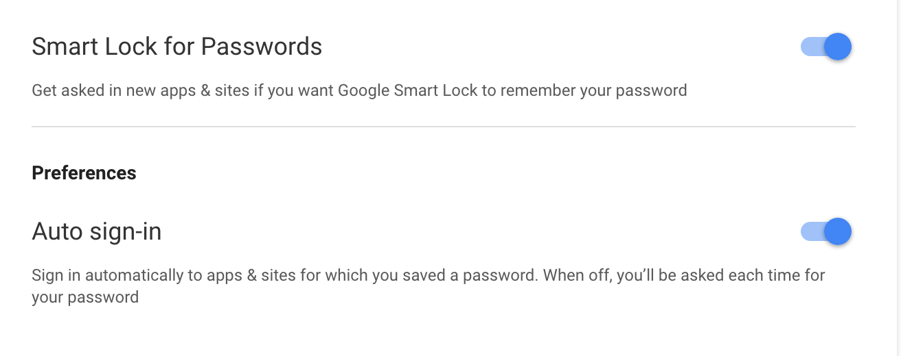
Password manager
Browser plug-in that stores encrypted copy of passwords for each site (unlocked by a single password)
Allows creation of random passwords for each server
Decreases attacker ability to guess password
Main drawback: synchronization between devices

Slide 35
Hardware
Use of specialized hardware to generate password like tokens
Yubikey
RSA SecureID
Must now be carried with user

Slide 36
SMS
User is sent text message with short code (usually six digits)
Idea is to strengthen and randomize password
Requires attacker to compromise phone and desktop device

Slide 37
Federated
Many service providers offer what is known as single sign on
They take responsibility for managing identity
Creates larger target for compromise but services have more incentive to invest in security
Kerberos, OpenID, Google ID, Facebook

Slide 38
Reading
K. Fu E. Sit, K. Smith, N. Feamster, Do’s and Don’ts of Client Authentication on the Web, USENIX conference 2001.
J. Bonneau, C. Herley, P. van Oorschot, F. Stajano, The Quest to Replace Passwords, IEEE Security and Privacy 2012

