Slide 1
CSE 4095
Lecture 22 – BlockChain
Slides adapted from Claudio Orlandi

Slide 2
Bitcoin Privacy
Each Bitcoin carries the entire transaction history with it
This history should be verified before the coin is accepted
A user can create multiple identities, however they have to transfer coins between them, it is possible to correlate these identities
Only real anonymity is to transform bitcoin into some other commodity and then re-enter the system

Slide 3
Zerocoin – Adding privacy to Bitcoin
New approach to creating electronic coins
Based on a technique due to Sander and Ta-shma
Extends Bitcoin by adding a ‘decentralized laundry’
Requires only a trusted, append-only bulletin board
Bitcoin block chain gives us this!

Slide 4
Making Zerocoin
Zerocoins are just numbers
Each is a digital commitment to a random serial number
Anyone can make one!
823848273471012983

Slide 5
Commitments
Two phase cryptographic protocol, Commitment and Open
Commitment produces a value c that binds the committed value without revealing it
Simultaneously hard to:
Open to a different value
Learn about committed value before it is opened
Commitments are transferable, just need to transfer committed value and randomness used
823848273471012983

Slide 6
Making Zerocoin
Zerocoins are just numbers
They have value once you put them on the block chain
This costs e.g., 1 bitcoin
1.0,A->B
1.0,J->Z
.23,C->E
.23,E->F
.23,E->F
1.03,S->J
bitcoins
1.0,
1.2,E->J
.9,M->B
.9,M->B
2.5,M->S
.9B->D
.2,M->J
1.0->Z
1.0->Z
...
...
...
...
...
HASH
HASH
HASH
HASH
Block 1
Block 2
Block 3
Block 4
Block 5

Slide 7
Spending Zerocoin
1.0,A->B
1.0,J->Z
.23,C->E
.23,E->F
.23,E->F
1.03,S->J
bitcoins
1.0,
1.2,E->J
.9,M->B
1.0,Z->B
2.5,M->S
.9B->D
.2,M->J
1.0->Z
bitcoins
1.0->Z
...
...
...
...
...
HASH
HASH
HASH
HASH
Block 1
Block 2
Block 3
Block 4
Block 5

Slide 8
Spending Zerocoin
Where do the bitcoins go/come from?
Nowhere -- they get ‘escrowed’ in place
A Zerocoin spend transaction allows you to claim the coins left by some other Zerocoin user
1.0,A->B
1.0,J->Z
1.0,C->E
.23,E->F
.23,E->F
1.03,S->J
1.0,
1.2,E->J
.9,M->B
bitcoins
1.0,Z->B
2.5,M->S
.9B->D
.2,M->J
1.0->Z
1.0->Z
...
...
...
...
...
HASH
HASH
HASH
HASH
Block 1
Block 2
Block 3
Block 4
Block 5

Slide 9
Spending Zerocoin
Why is this anonymous?
It’s all in the way we ‘prove’ we have a Zerocoin
This is done using a zero knowledge proof
1.0,A->B
1.0,J->Z
1.0,C->E
.23,E->F
.23,E->F
1.03,S->J
1.0,
1.2,E->J
.9,M->B
.9,M->B
2.5,M->S
.9B->D
.2,M->J
1.0->Z
1.0->Z
...
...
...
...
...
HASH
HASH
HASH
HASH
Block 1
Block 2
Block 3
Block 4
Block 5

Slide 10
Spending Zerocoin
Zero knowledge [Goldwasser, Micali 1980s, and beyond]
Prove a statement without revealing any other knowledge
Specific variant: proof of knowledge
Here we prove knowledge of: (a) a Zerocoin in the block chain (b) we just revealed the actual serial number inside of it
The trick is doing this efficiently!

Slide 11
Spending Zerocoin
Inefficient proof
Identify all valid Zerocoins in the blockchain (call them )
Prove knowledge of such that:
These ‘or’ proofs have cost O(N)

Slide 12
Spending Zerocoin
Better approach
Use an efficient one-way accumulator
Accumulate to produce accumulator
Then prove knowledge of a witness s.t.

Slide 13
Spending Zerocoin
Better approach
Use an efficient one-way accumulator
Accumulate to produce accumulator
Then prove knowledge of a witness s.t.
A
H(C1,C2)
H(C3,C4)
H(C1)
H(C2)
H(C3)
H(C4)

Slide 14
Spending Zerocoin
Better approach
Use an efficient one-way accumulator
Accumulate to produce accumulator
Then prove knowledge of a witness s.t.
A
= sibling nodes
H(C1,C2)
H(C3,C4)
H(C1)
H(C2)
H(C3)
H(C4)

Slide 15
Spending Zerocoin
Problem:
There are relatively few accumulators that meet our criteria
Computing the accumulator should not require any secrets (i.e., it’s publicly computable/verifiable)
There must be an efficient ZK proof of knowledge of a witness.
Merkle trees don’t (seem) to possess one

Slide 16
Strong RSA Accumulator (Benaloh & de Mare)
To accumulate primes compute:
An efficient ZKPoK proposed by Camenisch/Lysyanskaya ’01!

Slide 17
The upshot
I can take Bitcoin from my wallet
Turn them into Zerocoins
Where they get ‘mixed up’ with many other users’ coins
I can redeem them to a new fresh Wallet
Nobody will be able to link the new ones to the old!

Slide 18
Use of Blockchain

Slide 19
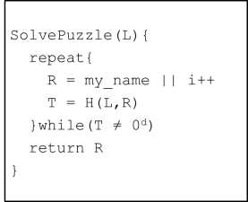
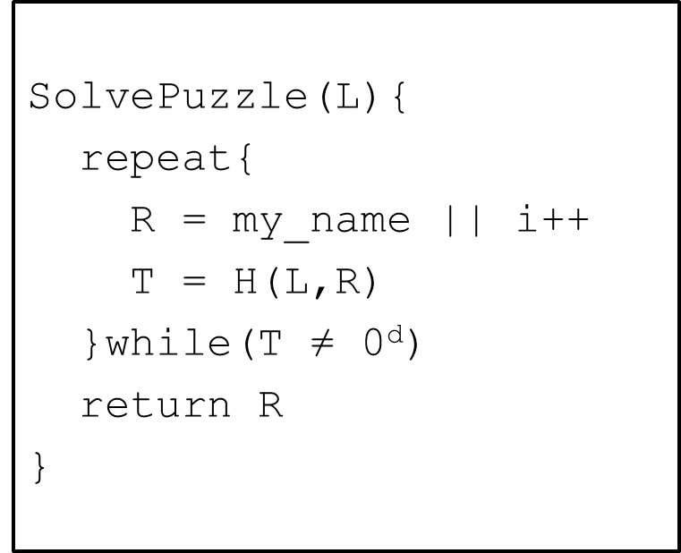
Blockchain Structure
SolvePuzzle(L,...){
repeat{
R = my_name||(m,s)|| i++
T = H(L,R)
}while(T ≠ 0^{d})
return R
}
P₁
(m,s)
P₃
(m,s)
P₂
(m,s)
P₄
P3 broadcasts transaction, is not accepted until incorporated into block chain
x₄=(P4, (m,s), i₄)

Slide 20
Preventing double spending /changes
The receiver wants to be sure that transaction is part of the “final” blockchain and cannot be undone
x₃=(P₃, i₃)
x₆=(P₃, i₆)
x₇=(P₃, i₇)
x₀=Start!
x₁=(P₁, i₁)
x₂=(P₂, i₂)
x₄=(P₄, i₄)
x₅=(P₅, i₅)
Wait to accept until transaction is several blocks back in the chain
Adversary’s ability to rewrite blocks decreases exponentially with number of blocks IF they control less than 50% of processing (of most popular branch)

Slide 21
Fundamental Characteristics of Blockchain
x₃=(P₃, i₃)
x₆=(P₃, i₆)
x₇=(P₃, i₇)
x₀=Start!
x₁=(P₁, i₁)
x₂=(P₂, i₂)
x₄=(P₄, i₄)
x₅=(P₅, i₅)
Blockchain is a distributed append only database, correctness is guaranteed when the adversary is spending less resources on the chain than honest parties
Honest participation requires incentive (costs compute cycles & electricity), achieved in Bitcoin using transaction fees & mining
Main innovation is achieving these properties without a trusted third party
Append only databases are easy with trusted party
Currently lots of hype surrounding blockchain, many applications are silly

Slide 22
Exercise: Useful or Silly, Financial Markets
The idea: use blockchain to distribute current markets like the NYSE removing the need for a trusted party
The pitch: will make markets more inclusive, reduce cost by reducing collateral and settlements
Is this a good application of blockchain technology?
Does it use the fundamental characteristics of blockchain?

Slide 23
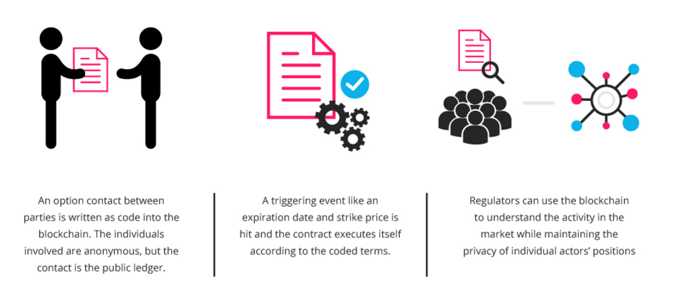
Exercise: Useful or Silly, Smart contracts
The idea: create digital self-enforcing digital contracts, remove the need for lawyers for external enforcement mechanisms, use the scripting language described last class
The pitch: no more lawyers, no need to sue for breach of contract
Is this a good application of blockchain technology?
Does it use the fundamental characteristics of blockchain?
Potential hangups with this application?
Notes:
Privacy, size of network?

Slide 24
Exercise: Useful or Silly, Voting
Is this a good application of blockchain technology?
Does it use the fundamental characteristics of blockchain?
Potential hangups with this application?
Notes:
Privacy, size of network?

Slide 25
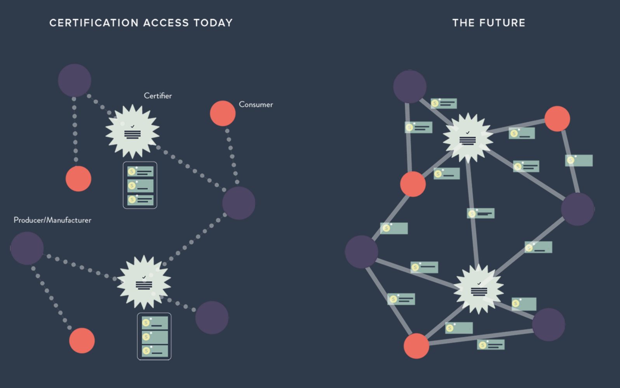
Exercise: Useful or Silly, Data Provenance
Is this a good application of blockchain technology?
Does it use the fundamental characteristics of blockchain?
Potential hangups with this application?
Notes:
Privacy, size of network?

Slide 26
Exercise: Useful or Silly, Cloud Storage
The idea: Distributed files to blockchain participants, provide coins in return for faithful storage of data, use blockchain to distribute and check correctness
The pitch: distributes trust from cloud storage providers, utilizes space that already exists
Is this a good application of blockchain technology?
Does it use the fundamental characteristics of blockchain?
Potential hangups with this application?
Notes:
Privacy, size of network?

