Slide 1
CSE 4095 TLS Attacks

Slide 2
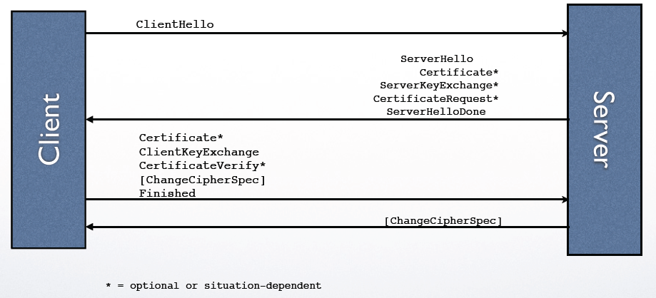
Handshake Protocol Diagram

Slide 3
TLS Attack Overview
TLS seems very well designed (it is well designed)
Most used security protocol on the Internet
Very strong incentive to attack the protocol
The attacks are clever, tricky, and difficult
Focus on the idea behind the attack and what we can learn
Omit some crucial details that can be found in research paper
Almost all attack target the handshake protocol
Most attacks target confidentiality of a session key

Slide 4
Handshake Protocol Diagram
Start here

Slide 5
Recall RSA
Public key is a modulus n = pq and an exponent e
Secret key is factorization and secret exponent d such that for any m, m^{ed} = m mod n
Encryption of m is just c = m^{e} mod n
Decryption of c is m = c^{d} mod n
Important property of RSA it is homomorphic, if c₁, c₂ are encryptions of m₁, m₂ then c₁*c₂ is encryption of m₁*m₂

Slide 6
Homomorphism is dangerous
Basic RSA scheme is deterministic: if the same message is encrypted twice it produces the same ciphertext
Homomorphism is also dangerous, it allows an attacker to change the message in a predictable way
To deal with both of these problems RSA encryption uses padding

Slide 7
RSA PKCS 1 v1.5 Padding
00 | 02 | 8 bytes of random | 00 | Actual Message
Used to prevent overflow
Specifies encryption
Provides randomization (nonzero)
Specifies end of random
PKCS padding also removes homomorphism
Unlikely that the product of two padded messages will be a a valid padded message
This padding was used in early TLS versions
Server uses alert protocol if decrypted message is not properly padded

Slide 8
Bleichenbacher attack
Client and Server TLS Negotiation
c = (00 | 02 | rand | 00 | premaster)^{e}
Agreed on premaster secret
Agreed on premaster secret
Wants to eavesdrop on the conversation between Alice
and Bob
Records their entire conversation, needs to learn premaster secret
“Chosen Ciphertext Attacks Against Protocols Based on the RSA Encryption Standard PKCS #1” Dan Bleichenbacher, CRYPTO 1998

Slide 9
Bleichenbacher attack
Client and Server TLS Negotiation
cs^{e}
Agreed on premaster secret
Engages in TLS negotiation with server
Server either responds with alert message or continues to finished messages (where it becomes clear attacker doesn’t know key)
Attacker can distinguish these cases!
Performs this negotiation multiple times with different s, probability of not having alert message is roughly 1/2²⁴
By birthday bound takes 2¹² messages for at least one to continue to finished
By some math attacker learns that 2* 2⁶²< ms mod n < 3* 2⁶²

Slide 10
Bleichenbacher attack
Client and Server TLS Negotiation
cs^{e}
Agreed on premaster secret
By some math attacker learns that 2* 2⁶²< ms mod n < 3* 2⁶²
By iterating the attack with different s, can gain different constraints on m
Eventually can determine premaster secret completely
The attack takes around 2²⁰ or 1 Million negotiations
Seems like a lot but powerful servers process this all the time
Google processes 10⁵ searches a second, only 10 seconds for 1 Million negotiations (many searches use session resumption which we haven’t covered)

Slide 11
Bleichenbacher attack
Client and Server TLS Negotiation
cs^{e}
Agreed on premaster secret
Exercise:
What went wrong here?
What can be done to fix it?

Slide 12
Bleichenbacher(cont’d)
Proposed remediations:
OAEP (optimal asymmetric encryption padding) new padding mechanism for RSA, greatly decreases chance of valid message, requires a cryptographic hash function, used in PKCS 1 v2.1
Try to silence the alert mechanism, have the server continue until the finished message
Requires the server to prepare messages in a way that can’t be detected by the client
What does server use as premaster secret?
LESSON: A small amount of information, whether a message is properly padded, can be devastating

Slide 13
Review of record encryption protocols
AES CBC
Camellia CBC
ARIA CBC
SEED CBC
3DES CBC
GOST CNT
IDEA CBC
RC2 CBC
RC4 (stream cipher)
Most cipher suites use cipher block chaining to create an encryption scheme out of block cipher
AES CBC was most common method

Slide 14
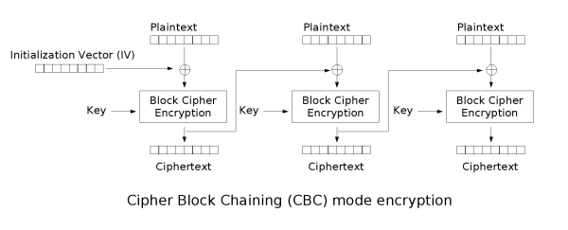
Cipher block chaining
Identical plaintext blocks are encrypted into different ciphertext blocks each block of plaintext is XORed with the previous ciphertext block before being encrypted
Initialization vector (IV) is used in the first block
IV: even when the same plaintext is encrypted multiple times independently with the same key gives distinct ciphertexts
IV not reused under the same key

Slide 15
CBC Data Injection
P0
P1
P2
IV
⊕
⊕
⊕
Enc
Enc
Enc
C0
C1
C2
Seemingly minor fact, if P2 = P1 ⊕ C1 ⊕ C0, then C2 = C1
C2 = Enc(P1 ⊕ C1 ⊕ C0 ⊕ C0) = Enc(P1 ⊕ C1) =C1

Slide 16
CBC Data Injection
P0
P1
P2
IV
⊕
⊕
⊕
Enc
Enc
Enc
C0
C1
C2
Seemingly minor fact, if P2 = P1 ⊕ C1 ⊕ C0, then C2 = C1
How could an attacker exploit this fact?

Slide 17
BEAST Attack
Client and Server Record Protocol
Encrypted/MAC’d Messages
Attacker tries to insert malicious data into record protocol
If attacker has guess x for plaintext block, can insert P1 ⊕ C1 ⊕ C0 into stream and check correctness
As a result can learn about client’s private data
How to actually pull this off?

Slide 18
BEAST Attack
Cookie 1
Evil.com
1. Provides client with java applet
Cookie 1
Cookie 2 Cookie 3
Cookie 1
Guess for Cookie
Not-Evil.com
Initiates connection to legitimate site
TLS connection automatically occurs
Client provides cookies to site automatically
Applet inserts plaintext blocks and guesses cookie values
Can initiate connection multiple times for multiple guesses
Relays values back to Evil.com

Slide 19
BEAST Attack
EXERCISE
What went wrong?
What could we do to fix it?
Cryptographically
Non-cryptographically
LESSONS?

Slide 20
BEAST Remediations
Same Origin Policy
Prevents java from accessing data on another connection unless those connections are to the same site
Same Origin Policy should have actually prevented this problem, BEAST exploited an implementation flaw
TLS completely moved away from using CBC mode, what is left?

Slide 21
Review of record encryption protocols
AES CBC
Camellia CBC
ARIA CBC
SEED CBC
3DES CBC
GOST CNT
IDEA CBC
RC2 CBC
RC4 (stream cipher)
Developed by Soviet/Russian government, not widely used

Slide 22
Lets go RC4!
Several attacks exploit CBC (BEAST, Varduney, Lucky Thirteen)
Varduney exploits the way data is padded to form a last block
Lucky 13 extends this attack to only use timing information
Use the structure of how CBC prepares data
Belief: block ciphers will always have these problems
Lets try a stream cipher
RC4 is only option
Saw RC4 in the WEP protocol

Slide 23
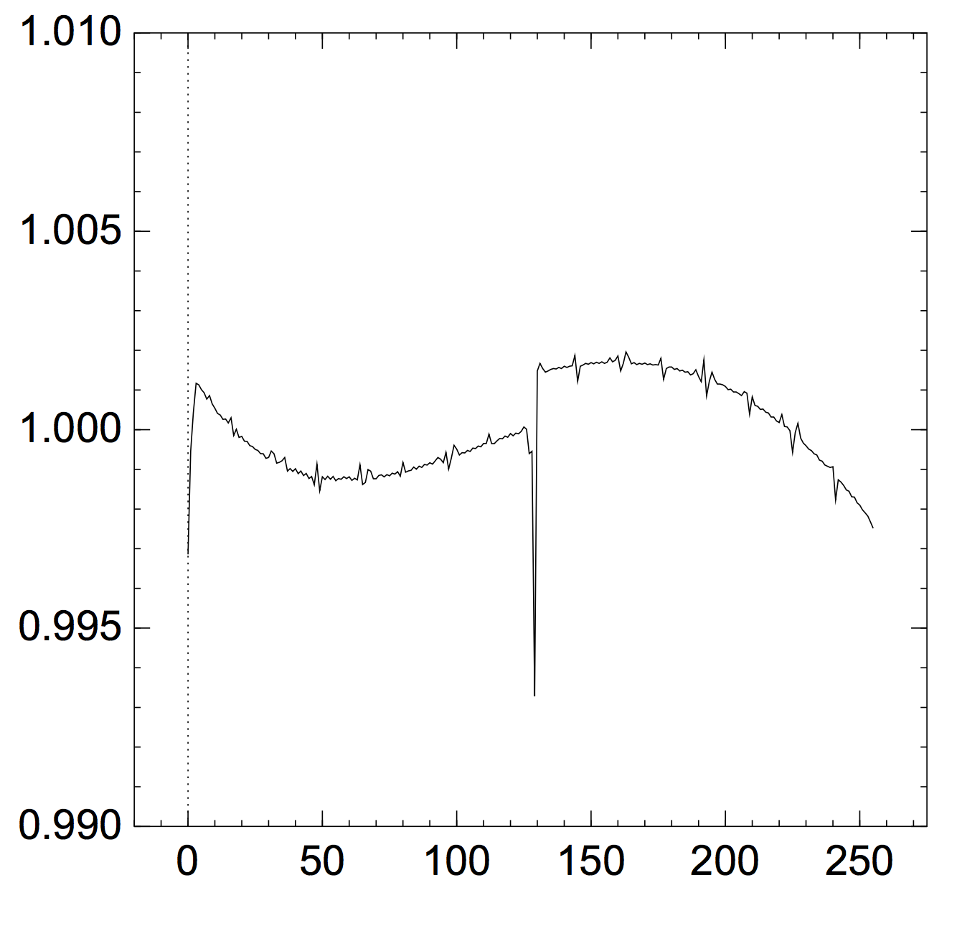
RC4
Stream cipher designed in early 90s
Was not attacked in WEP (were so many weak points)
Started researchers in attacking the protocol
The first bytes of RC4 output are biased and reveal about key/plaintext
First byte output
See more biases at: http://cr.yp.to/talks/2013.03.12/slides.pdf

Slide 24
RC4
Probability of recovering byte at position x with 2²⁴ ciphertexts
Attack almost 100% with 2³² ciphertexts
On the Security of RC4 in TLS Al Fardan, Bernstein, Paterson, Poettering, Schdult, 2013

Slide 25
RC4
Banned from TLS in 2015
What can we learn from this process?
More attacks next class (compression and protocol downgrade attacks)

