Slide 1
How do computers know who I am?
They are mostly guessing
Prof. Ben Fuller, Computer Science and Engineering
09/07/2016

Slide 2
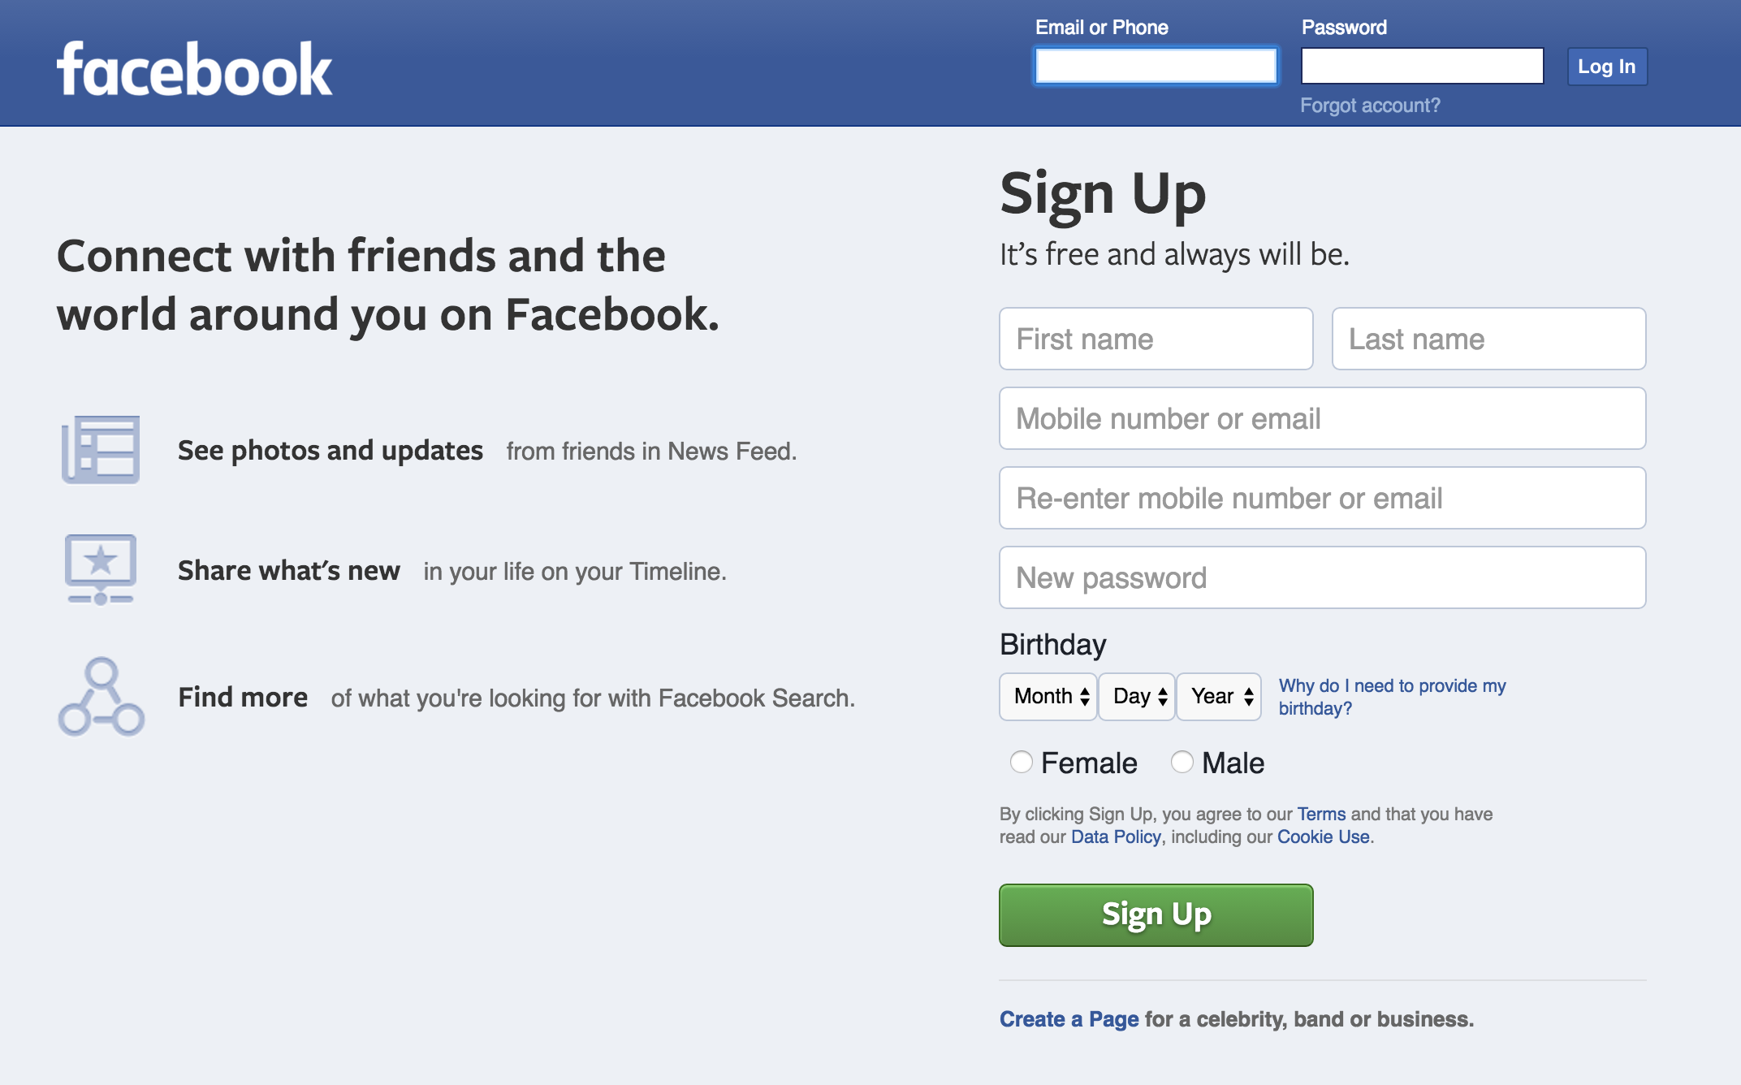
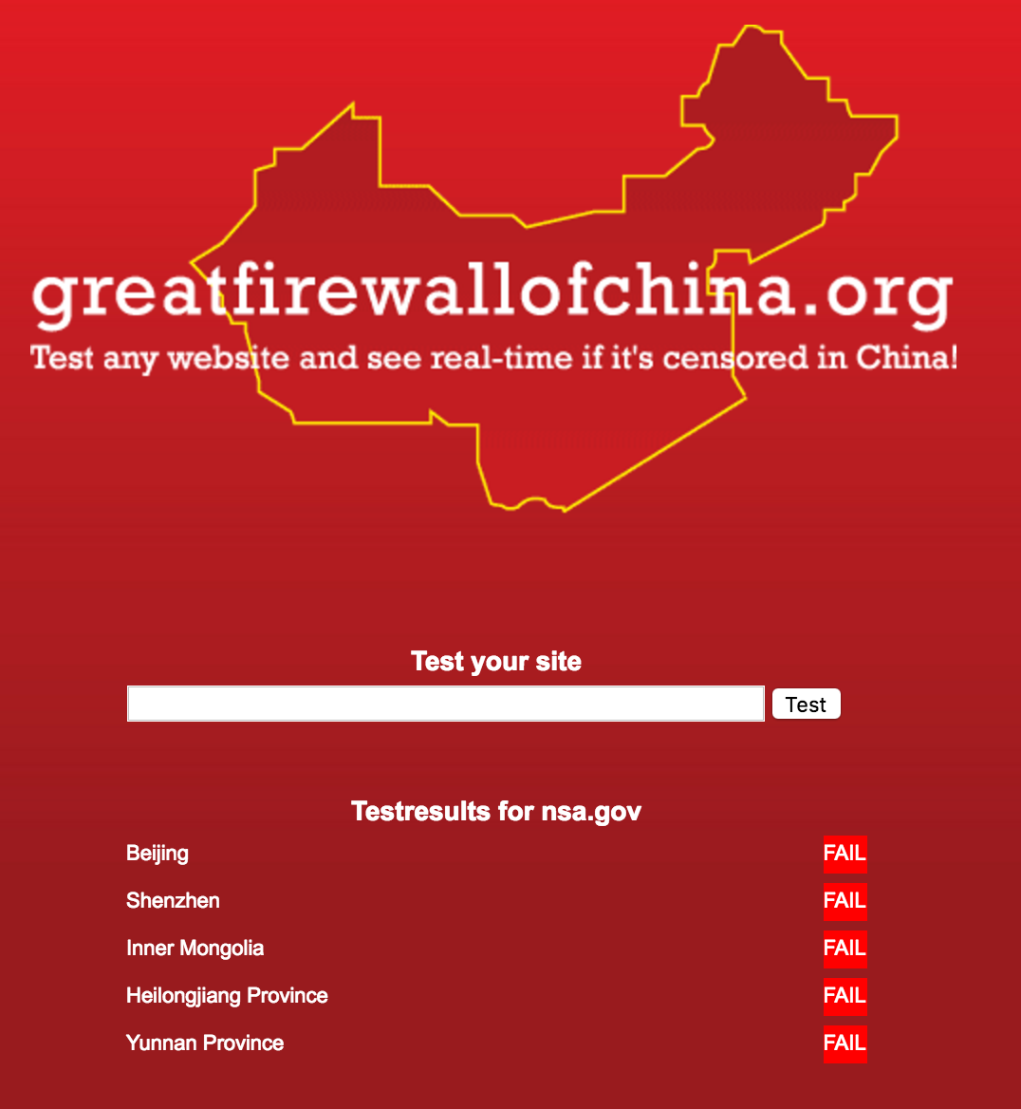
Why do I care if computers know who I am?
Computers are able to perform actions on your behalf, for instance post on your Facebook wall
Other people implicitly trust when they receive a message from another person that they intended to send it
How would you feel if you got a text from your partner saying they are breaking up with you? What would be your first reaction?
Nearly every important regulation/law/decision is enforced/communicated in part using computers

Slide 3
What could you do if computers thought you were me?
Grade students
Admit students to graduate school
Piss off my friends
Withdraw money from my bank
Take out credit cards in my name
Alter my reputation
Hack other computers and blame me (maybe get me put in jail)

Slide 4
Turns out I’m not that powerful
What could you do if you could impersonate a company executive?
An important religious figure?
Susan Herbst?
A military commander?
A president?
An operator of a nuclear power plant?

Slide 5
Goal: be sure who is requesting an action before performing it
Usually called “authentication”
Should be able to tell who asked for the action, understand what they are allowed to do, and approve or reject the action
Should also be able to determine if the request is current
What’s necessary for a computer to do this?
Must be able to identify the individual

Slide 6
Is identity enough?
In a perfect world identity would be enough
There’s a lot of gain from impersonating others, people try it all the time
Uniquely identifies a person and the attacker doesn’t know
Want something that is difficult to guess
By who???
-BusinessInsider, Dec. 2013

Slide 7
What about me might be hard to guess?
Private Information | Who else knows it?
Where I grew up | Family, friends, facebook
Mother’s maiden name | Family, legal forms, employer
Where I live | Employer, federal local government
Who I vote for | Facebook
Who I have a crush on | Friends
Social security/license information | Government, credit agencies
Health records | Insurance, doctors
There is little information we about us that is private from everyone

Slide 8
My inner most thoughts
All the examples were easily impacted or observed by the outside world
Maybe we need to use inner most thoughts?
Are these unique and hard to guess?
How to tell a unique thought from a commonplace one?
Research indicates that the average person talks to him/herself about 55,000 words per day.
the average person thinks approximately 65,000 thoughts per day. The study also went on to conclude that of these 65,000 thoughts, about 95% are exactly the same thoughts that passed through the minds of these people the day before.

Slide 9
Along come passwords
To ensure uniqueness people came up with an idea: the password
The idea is to ask users to have a unique innermost thought that is never shared with anyone, this will be used to identify them
Seems easy right?
I. Two essential password rules:
Following two rules are bare minimal that you should follow while creating a password. Rule 1 – Password Length: Stick with passwords that are at least 8 characters in length. The more character in the passwords is better, as the time taken to crack the password by an attacker will be longer. 10 characters or longer are better.
Rule 2 – Password Complexity: Should contain at least one character from each of the following group. At least 4 characters in your passwords should be each one of the following.
Lower case alphabets
Upper case alphabets
Numbers
Special Characters

Slide 10
Along come passwords
To ensure uniqueness people came up with an idea: the password
The idea is to ask users to have a unique innermost thought that is never shared with anyone, this will be used to identify them
Seems easy right?
I call the above two rules combined as “8 4 Rule” (Eight Four Rule):
8 = 8 characters minimum length
4 = 1 lower case + 1 upper case + 1 number + 1 special character.
Just following the “8 4 Rule” will be a huge improvement and instantly make your password much stronger than before for most of you who don’t follow any guidelines or rules while creating a passwords. If your banking and any financially sensitive website passwords doesn’t follow the “8 4 Rule”, I strongly suggest that you stop everything now and change those passwords immediately to follow the “8 4 Rule”.

Slide 11
Along come passwords
To ensure uniqueness people came up with an idea: the password
The idea is to ask users to have a unique innermost thought that is never shared with anyone, this will be used to identify them
Seems easy right?
II. Guidelines for creating strong passwords:
Follow “8 4 Rule”. Like I mentioned above this is the foundation of creating a strong password.
Unique Characters. Should contain at least 5 unique characters. You already have 4 different character if you’ve followed “8 4 Rule”.
Use Password Manager. Strong passwords are hard to remember. So, as part of creating a strong password you need a reliable and trustworthy way of remembering the strong password. Using password management tool to store passwords should really become a habit. Anytime you create a password, note it down on a password manager tool, that will encrypt the password and store it safe for you

Slide 12
Along come passwords
To ensure uniqueness people came up with an idea: the password
The idea is to ask users to have a unique innermost thought that is never shared with anyone, this will be used to identify them
Seems easy right?
Use Passphrase. If you don’t want to use password management tool, Use Passphrase to easily remember the passwords. You can use initials of a song or a phrase that are very familiar to you. for e.g. “Passwords are like underwears, change yours often!” phrase can be converted to a strong password “Prlu,Curs0!”

Slide 13
Along come passwords
To ensure uniqueness people came up with an idea: the password
The idea is to ask users to have a unique innermost thought that is never shared with anyone, this will be used to identify them
Seems easy right?
III. Guidelines for avoiding weak passwords.
Avoid the following in your passwords. Even part of your passwords should not be anything in the following items.
Password same as username or part of the username
Name of family members, friends or pets.
Personal information about yourself or family members. This includes the generic information that can be obtained about you very easily, such as birth date, phone number, vehicle license plate number, street name, apartment/house number etc.
Sequences. i.e consecutive alphabets, numbers or keys on the keyboard. for e.g. abcde, 12345, qwert.
Dictionary words. Dictionary words with number or character in front or back
Real word from any language

Slide 14
Along come passwords
To ensure uniqueness people came up with an idea: the password
The idea is to ask users to have a unique innermost thought that is never shared with anyone, this will be used to identify them
Seems easy right?
….
Word found in dictionary with number substitution for word look alike. for e.g. Replacing the letter O with number 0. i.e passw0rd.
Any of the above in reverse sequence
Any of the above with a number in front or back.
Empty password

Slide 15
Along come passwords
To ensure uniqueness people came up with an idea: the password
The idea is to ask users to have a unique innermost thought that is never shared with anyone, this will be used to identify them
Seems easy right?
IV. Common sense about passwords:
All the following points are nothing new and very much common sense. But most of the time, we tend to ignore these items.
Create unique password every time. When you are changing a password for an existing account, it should not be the same as the previous password. Also, do not use incremental passwords while changing it. i.e password1, password2 etc.
Change your passwords for all your accounts once every 6 months. Since passwords have a fixed length, a brute-force attack to guess the password will always succeed if enough time and processing power was available to the attacker. So, it is always recommended to change the passwords often. Schedule an recurring appointment on your calendar to change your passwords once every 6 months.

Slide 16
Along come passwords
To ensure uniqueness people came up with an idea: the password
The idea is to ask users to have a unique innermost thought that is never shared with anyone, this will be used to identify them
Seems easy right?
Never write down your passwords. Creating a very strong password and writing it down on a paper is as bad as creating an easy to remember weak password and not writing it down anywhere. There are several interesting surveys done on this subject, where it was found that several people write down the password and keep it somewhere next to the computer. Some of them think keeping the post-it note below the mouse pad is secure enough. You should never write down the password on a paper. If you want to carry your password along with you all the times, use a password manager tool that runs from USB stick and take that with you all the times.
Don’t share with anyone. Anyone includes your friends and family. Probably you might have heard the phrase “Passwords are like underwear, don’t share with anybody”. We teach our kids several things in life. …

Slide 17
Along come passwords
To ensure uniqueness people came up with an idea: the password
The idea is to ask users to have a unique innermost thought that is never shared with anyone, this will be used to identify them
Seems easy right?
Never keep the same password for two different sites. It is very tempting to create one set of passwords for all your emails, another password for all the banking sites, another password for all the social networking sites etc. Avoid this temptation and keep unique passwords for all your accounts.
Don’t type your password when someone is looking over your shoulder. This is especially very important if you type slowly and search for the letters in the keyboard and type with one finger, as it is very easy for someone looking over your shoulder to figure out the password.
Never send your password to anybody in an email. If you follow #3 mentioned above, this should not be an option. But the reason I’m specifically saying about this is because several hackers send emails as a support person and asking for your user name and password through email….

Slide 18
Along come passwords
To ensure uniqueness people came up with an idea: the password
The idea is to ask users to have a unique innermost thought that is never shared with anyone, this will be used to identify them
Seems easy right?
Change password immediately when they are compromised. Even if you have the slightest doubt that someone might have stolen your password, change it immediately. Don’t even waste a minute.
Don’t use the “Remember password” option on the browser without setting the Master Password. Don’t use this feature of the browser to store your username and passwords without enabling the “Master Password” option. If you don’t set master password on the firefox browser, anybody who uses your firefox browser can see all the passwords that are stored in the firefox browser in plain text. Also, be very careful with this option and say ‘Not Now’ in the remember password pop-up, when you are using a system that doesn’t belong to you.
Don’t type your password on a computer that does not belong to you. If possible, don’t use someone else computer …

Slide 19
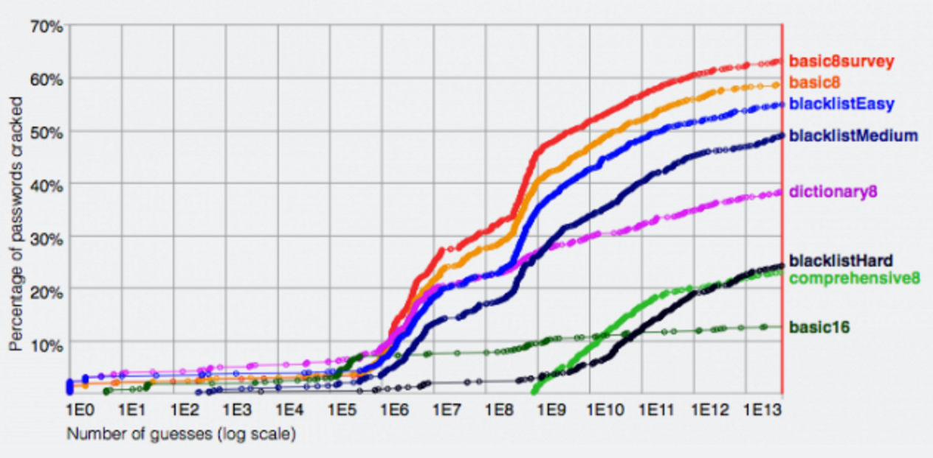
Just 87 simple rules for creating a good password!
What’s worse, every website has a different policy for how to create passwords
And you aren’t supposed to reuse them
And you should change them every couple of months
And you shouldn’t write them down
How many unique passwords do we actually use?
Over half of UK adults use the same password to access internet sites
One in four use birthdays or names as passwords

Slide 20
Why are things so complicated?
We had such a simple idea, why did things get so complicated?
Because there’s still a lot of money to be made
People invest hundreds of thousands of dollars into password cracking rigs
How does this process work?

Slide 21
How are passwords stored
3 basic varieties:
Plaintext: computer just stores the right password, no need to guess just break into computer and see it
Hashed: computer stores a transformed version of the password that is the same everywhere
Salted: computer uses a different transform for the password
The world of password cracking

Slide 22
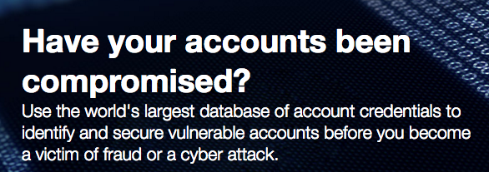
Password compromises

Slide 23
How does password cracking work?
Algorithms try to guess passwords in decreasing likelihood and check correctness
Very efficient on GPUs which are designed for parallel computation
Simplest algorithm is just enumerate strings in increasing length
Good rigs exhaust 8 character passwords in hours
https://youtu.be/JT4P_ZQuv9k?t=3m

Slide 24
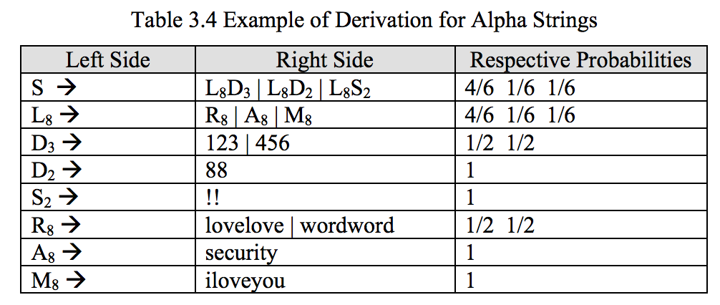
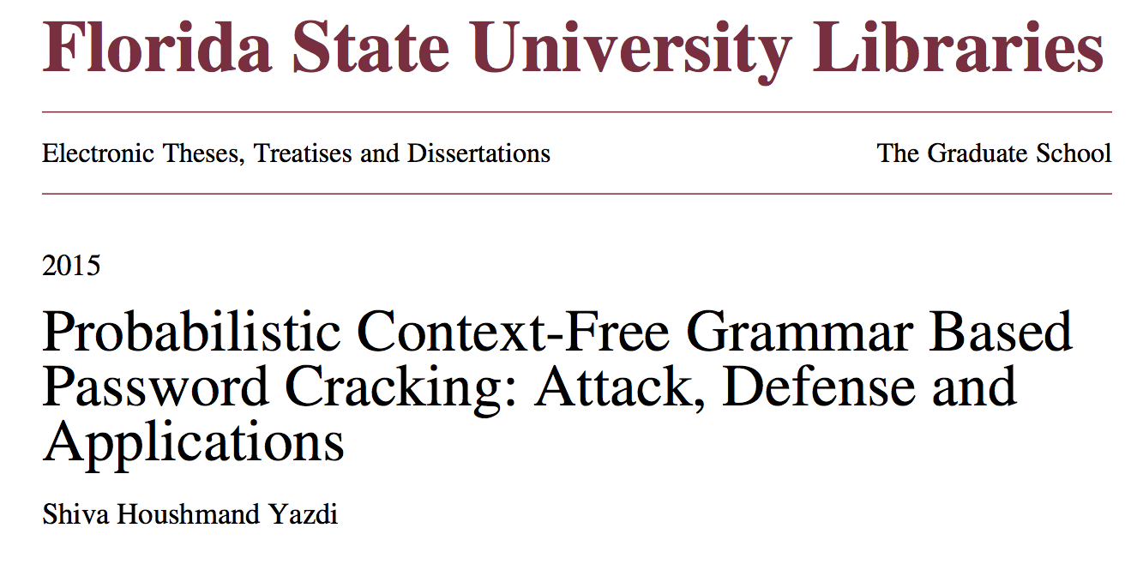
How does password cracking work?
More advanced systems predict how people create passwords based on previous password leaks

Slide 25
How secure is my password
If an attacker can try multiple times and check if they are right, not very http://arstechnica.com/security/2013/05/how-crackers-make-minced-meat-out-of-your-passwords/
This is called an offline attack, salting is supposed to prevent this (unless the server is compromised
If a server can effectively limit the number of guesses then security is in your hands, possible to create decent passwords
Every system of this form requires a reset or unlock functionality often point of vulnerability

Slide 26
What is being done?
Most services only authenticate you with a password periodically
On subsequent logins, they store “cookies” on your computers that serve as much stronger passwords

Slide 27
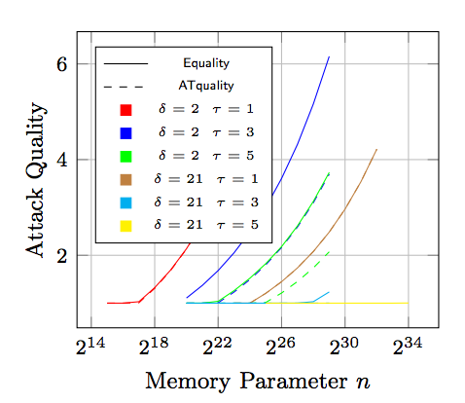
What is being done?
Creation of new hashing algorithms that are hard for GPUs because they require a lot of memory to compute (or take longer to compute)
Difficult for the server to parallelize as well
https://password-hashing.net/

Slide 28
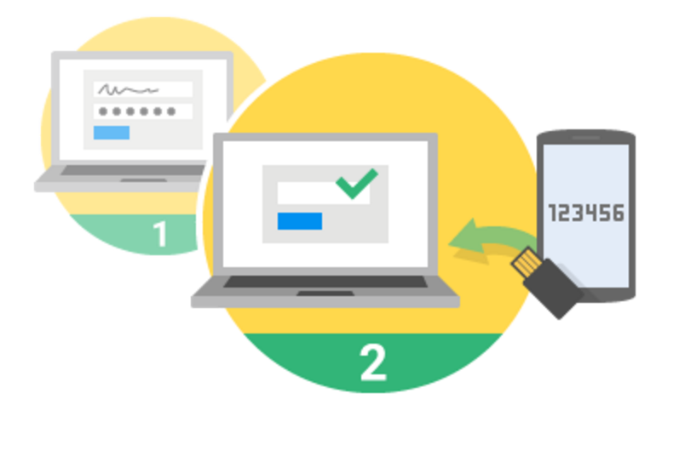
What is being done?
Services send a text message or email on first login in increase password strength
Relies on inability of attacker to see text or email communication
Codes are generally short to keep user burden small

Slide 29
What is being done?
Password managers allow a user to use a single (weaker) password to unlock a large number of hard passwords
These can be different for each service and updated regularly
Difficult to sync between devices (unless stored online in which cause it’s a target for attacks)

Slide 30
What is being done?
High value services provide users with physical devices that augment passwords
Costs more, difficult to manage
Attacker with physical access can recover physical device

Slide 31
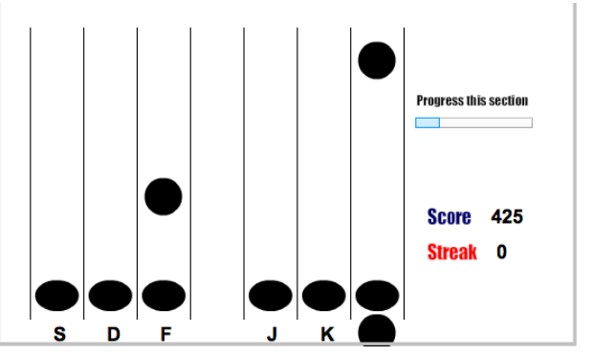
What is being done?
Development of new techniques to increase password strength
Use of implicit learning and understand of human memory

Slide 32
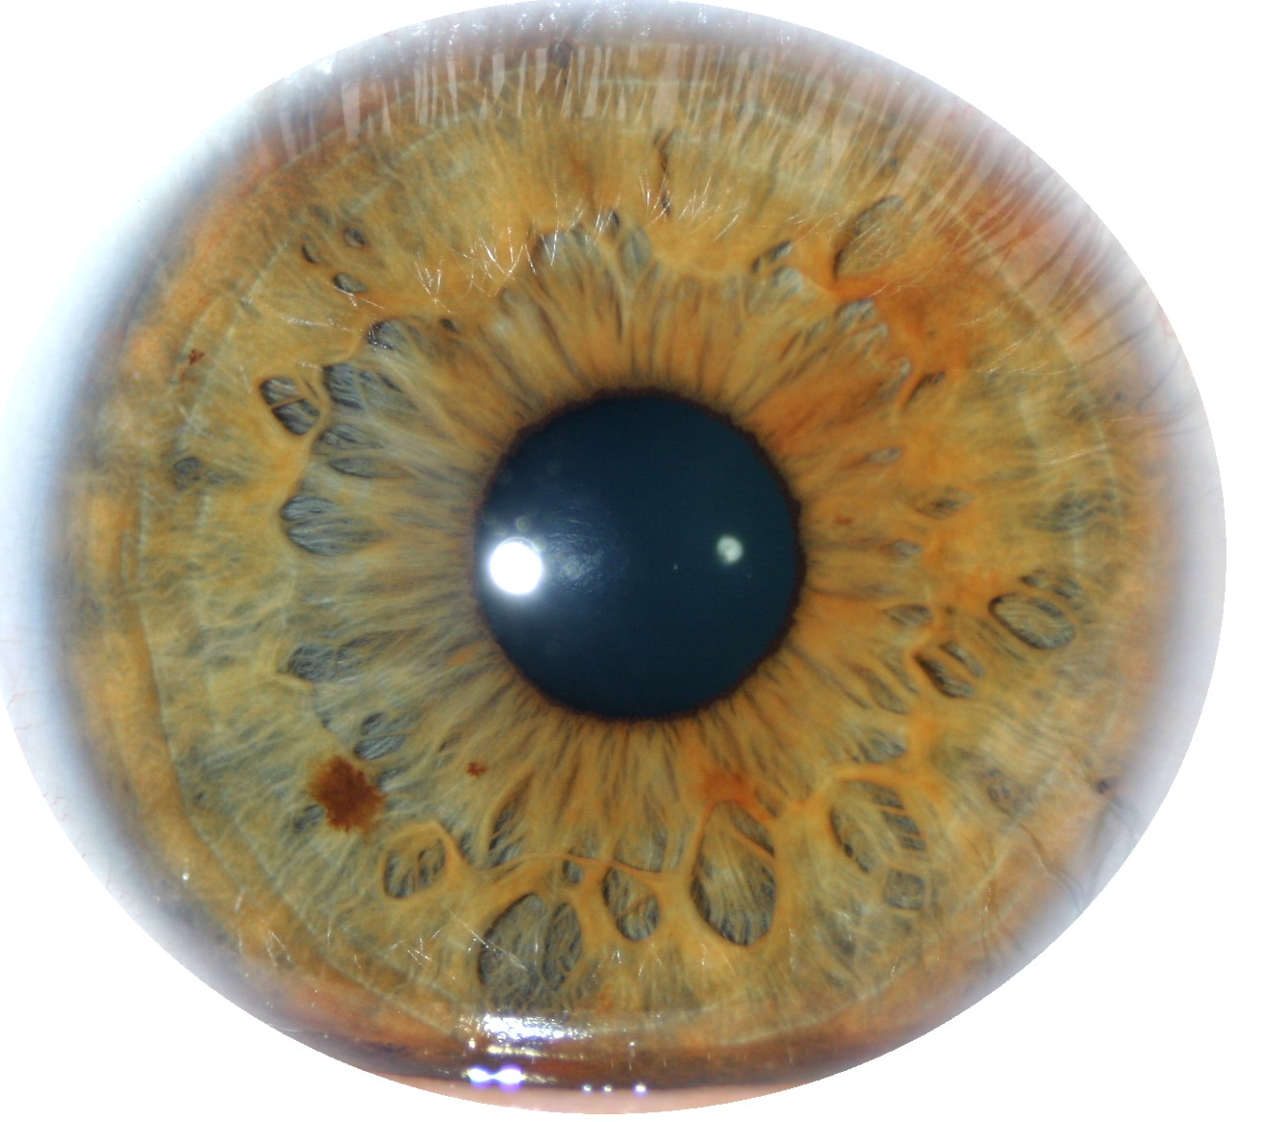
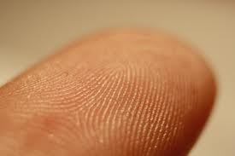
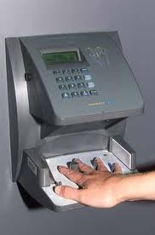
What is being done?
Human biometrics
Use fingerprint, iris, gait, DNA, as additional material
Can’t be changed, may be left accidentally or available online
This is my area of research!

Slide 33
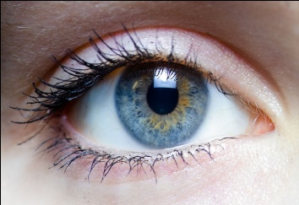
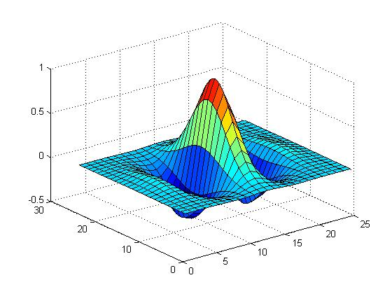
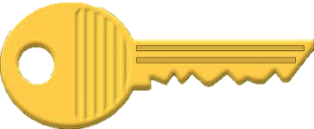
Biometric Security
Locating the iris
Iris unwrapping
Iris code
Fuzzy Extractor
*
Filtering and 2-bit phase quantization

Slide 34
Why are passwords still in use?
Diversity of requirements
Low cost of replacement
Multiple alternatives
Misaligned incentives
Decentralized control
Will passwords still be the dominant authentication procedure in 2020?

