Slide 1
Reusable Fuzzy Extractors for Low-Entropy Distributions
Benjamin Fuller
Joint work with Ran Canetti, Omer Paneth, Adam Smith, and Leonid Reyzin
May 9, 2016
Notes:
1
1

Slide 2
Key Derivation from Noisy Sources
Physically Unclonable Functions (PUFs) [PappuRechtTaylorGershenfeld02]
interference
Gabor Hash
Laser
Hardware that implements random function
Impossible to copy precisely
Large challenge/response space
On fixed challenge, responses close together
Notes:
http://sigma.octopart.com/14152599/image/Microchip-TC14433EPG.jpg
http://www.drgaelriverz.com/images/Round_Eye.JPG

Slide 3
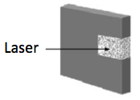
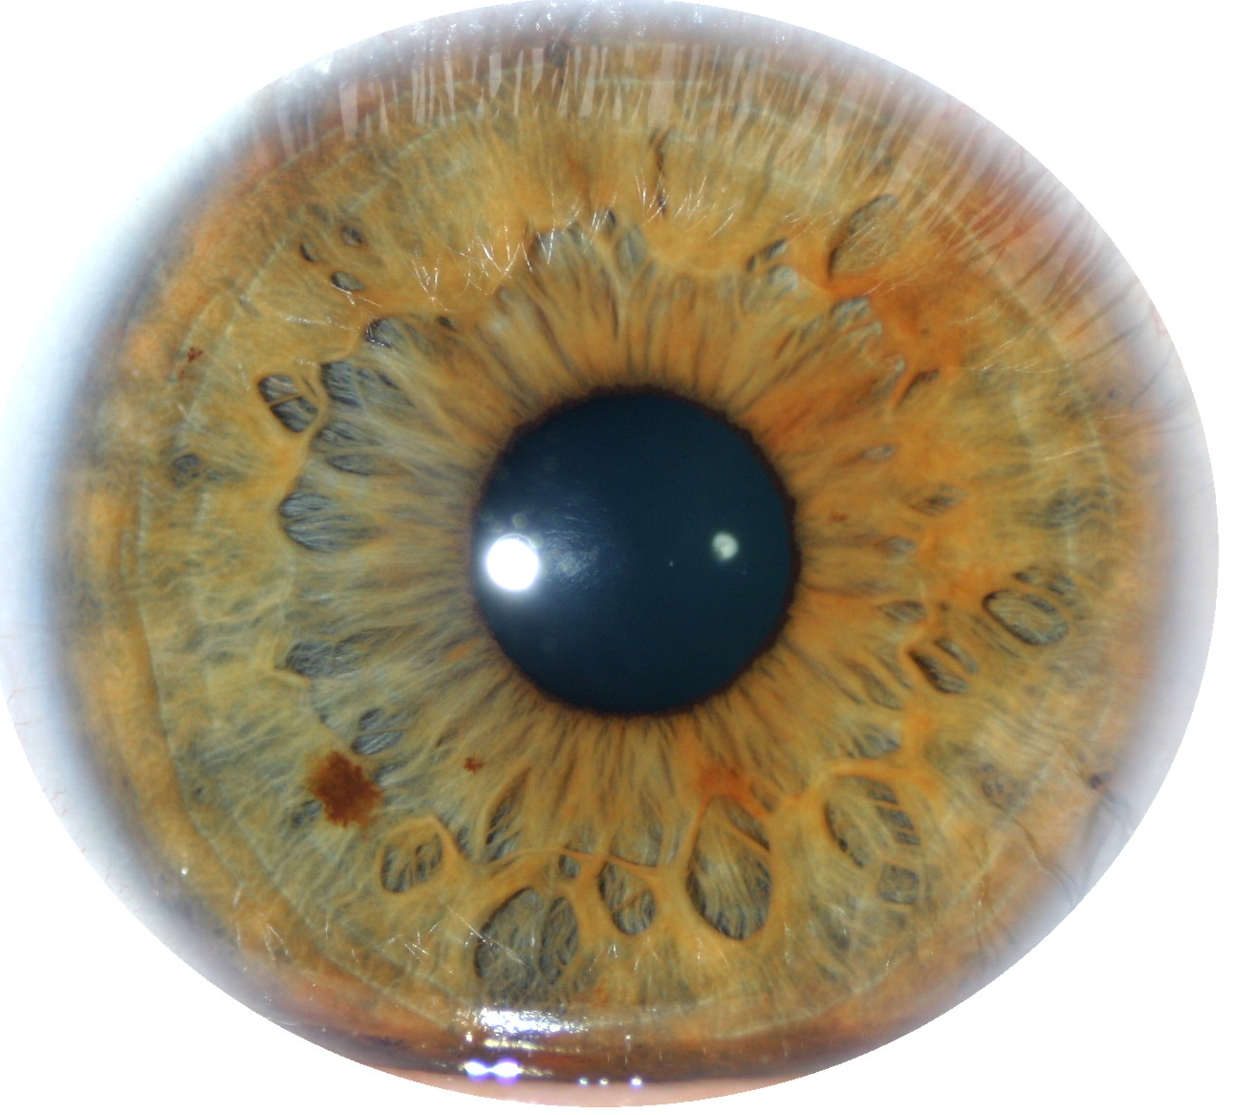
Key Derivation from Noisy Sources
Physically Unclonable Functions (PUFs)
Biometric Data
Measure unique physical phenomenon
Unique, collectable, permanent, universal
Repeated readings exhibit significant noise
Uniqueness/Noise vary widely
Human iris believed to be “best” [Daugman04], [PrabhakarPankantiJain03]
Notes:
http://sigma.octopart.com/14152599/image/Microchip-TC14433EPG.jpg
http://www.drgaelriverz.com/images/Round_Eye.JPG

Slide 4
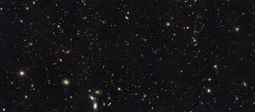
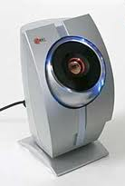
Modeling Entropy Sources
w₀
Entropy
w₀ – create a new biometric or hardware device, take initial reading
w₁
Noise
w₁ – take new reading from a fixed biometric or hardware device
Two readings may not be subject to same noise. Often less error in original reading

Slide 5
Key Derivation from Noisy Sources
Physically Unclonable Functions (PUFs)
Biometric Data
High-entropy sources are often noisy
Initial reading w₀ ≠ later reading reading w₁
Source w₀ = a₁,…, a_{k}, each symbol a_{i} over alphabet Z
Assume a bound on distance: d(w₀, w₁) ≤ t
d(w₀, w₁)=# of symbols in that differ
d(w₀, w₁)=4
w₀
A | B | C | A | D | B | E | F | A | A
A | G | C | A | B | B | E | F | C | B
w₁
Notes:
http://sigma.octopart.com/14152599/image/Microchip-TC14433EPG.jpg
http://www.drgaelriverz.com/images/Round_Eye.JPG

Slide 6
Key Derivation from Noisy Sources
Physically Unclonable Functions (PUFs)
Biometric Data
High-entropy sources are often noisy
Initial reading w₀ ≠ later reading reading w₁
Source w₀ = a₁,…, a_{k}, each symbol a_{i} over alphabet Z
Assume a bound on distance: d(w₀, w₁) ≤ t
Goal: derive a stable cryptographically strong output
Want w₀, w₁ to map to same output
The output should look uniform to the adversary
Challenge: Traditional approaches do not provide adequate security for many physical sources
Notes:
http://sigma.octopart.com/14152599/image/Microchip-TC14433EPG.jpg
http://www.drgaelriverz.com/images/Round_Eye.JPG

Slide 7
Contribution
Reusable key derivation from noise source with arbitrary correlation between repeated readings
Biometrics cannot be refreshed
Only previous construction [Boyen2004]: each reading must differ by fixed constants
Key derivation for large classes of sources with limited entropy (only super-log)
Previous approaches require linear entropy or strong assumption on distribution (for example, i.i.d. bits)

Slide 8
Outline
Strong Authentication through Key Derivation
Limitations of Traditional Approaches/Lessons
New Constructions

Slide 9
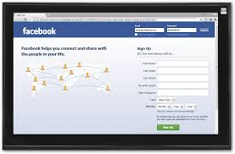
Key Derivation from Noisy Sources
Interactive Protocols [Wyner75] … [BennettBrassardRobert85,88] …lots of work…
Problem: User must store initial reading w₀ at server
w₀
w₁
Want approach where w₀ is not stored!
Parties agree on cryptographic key

Slide 10
Fuzzy Extractors: Functionality [JuelsWattenberg99], …, [DodisOstrovskyReyzinSmith04] …
Enrollment algorithm Gen: Take a measurement w₀ from the source. Use it to “lock up” random r in a nonsecret value p.
Subsequent algorithm Rep: give same output if d(w₀, w₁) < t
Security: r looks uniform even given p, when the source is good enough
Security can be information-theoretic [DORS04] or computational [FMR13]
Gen
r
w₀
Rep
p
r
< t
w₁

Slide 11
Fuzzy Extractors: Goals
Goal 1: handle as many sources as possible (typically, any source in which w₀ is 2^{k}-hard to guess)
Goal 2: handle as much error as possible (typically, any w₁ within distance t)
Most previous approaches are analyzed in terms of k and t
Traditional approaches do not support sources with limited entropy: where k < t (many practical sources)
Gen
r
entropy k
w₀
Rep
p
r
< t
w₁

Slide 12
Is it possible to handle “more errors than entropy”?
Iris: 2²⁴⁹ possible values of initial
Possible values of initial
Notes:
Lets consider a pictoral representation of possible initial values for the iris. This picture is simplified considerably as there are 2^249 possible values for initial

Slide 13
Is it possible to handle “more errors than entropy”?
Iris: Entropy = log (2²⁴⁹ )
Possible values of initial
Notes:
Lets consider a pictoral representation of possible initial values for the iris. This picture is simplified considerably as there are 2^249 possible values for initial

Slide 14
Is it possible to handle “more errors than entropy”?
Iris: Entropy = 249
Observed error rate (t) in iris between approximately 300
Possible values of initial
t
final
Recall: attacker can run Rep on any point
Notes:
Lets consider a pictoral representation of possible initial values for the iris. This picture is simplified considerably as there are 2^249 possible values for initial

Slide 15
Is it possible to handle “more errors than entropy”?
Iris: Entropy = 249
Observed error rate (t) in iris between approximately 300
Possible values of initial
t
final
Recall: attacker can run Rep on any point
Notes:
Lets consider a pictoral representation of possible initial values for the iris. This picture is simplified considerably as there are 2^249 possible values for initial

Slide 16
Is it possible to handle “more errors than entropy”?
Iris: Entropy = 249
Observed error rate (t) in iris between approximately 300
Possible values of initial
t
key
r
Rep
Attacker learns key by running Rep with final
Recall: attacker can run Rep on any point
Notes:
Lets consider a pictoral representation of possible initial values for the iris. This picture is simplified considerably as there are 2^249 possible values for initial

Slide 17
Is it possible to handle “more errors than entropy”?
Iris: Entropy = 249
Observed error rate (t) in iris between approximately 300
Possible values of initial
t
key
r
Rep
Key derivation is not possible if this is structure of iris
Recall: attacker can run Rep on any point
Notes:
Lets consider a pictoral representation of possible initial values for the iris. This picture is simplified considerably as there are 2^249 possible values for initial

Slide 18
Is it possible to handle “more errors than entropy”?
Iris: Entropy = 249
Observed error rate (t) in iris between approximately 300
Crucial fact: closest observed between distance two peoples irises is 680
Possible values of initial
t
key
r
Rep
Key derivation is not possible if this is structure of iris
Recall: attacker can run Rep on any point
Notes:
Lets consider a pictoral representation of possible initial values for the iris. This picture is simplified considerably as there are 2^249 possible values for initial

Slide 19
Is it possible to handle “more errors than entropy”?
Iris: Entropy = 249
Observed error rate (t) in iris between approximately 300
Crucial fact: closest observed between distance two peoples irises is 680
Possible values of initial
To secure iris need to use more than
Entropy of initial and
number of errors t
t
final
Recall: attacker can run Rep on any point
Notes:
Which corresponds to 249 bits of entropy. The observed error rate in iris measurement is around 300 bits between reading. Pictorally this means we need to accept any final in this radius. This seems like a lot of distance to accept, however, the closest known reading between two different people different in almost 700 bits. So if we set t=300 we should never confuse two people.
So the iris has more errors than entropy. The reason we might hope to derive keys is that different people are far apart so even if we accept readings distance 300 apart we will never confused two people.
However, traditional fuzzy extractors only consider the entropy and the number of errors (these were the only two parameters in the analysis). I’ll now show why this is a problem.

Slide 20
Is it possible to handle low entropy k < t ?
This distribution has 2^{k} points
Why might we hope to extract from this distribution?
Points are far apart
No need to deconflict original reading
Support of w₀
w₁
Notes:
ADS: Bullet structure too simple here: these items don’t all belong in one list

Slide 21
Is it possible to handle low entropy k < t ?
Support of w₀
Support of v₀
r
Since k < t there is a distribution v₀ where all points lie in a single ball
Left and right have same number of points and error tolerance
Notes:
ADS: Bullet structure too simple here: these items don’t all belong in one list

Slide 22
Is it possible to handle low entropy k < t ?
Support of w₀
Support of v₀
t
?
r
r
Rep
t
r
r
w₁
Rep
v₁
r
The likelihood of adversary picking a point w₁ close enough to recover r is low
For any construction adversary learns r by running with v₁
Recall: adversary can run Rep on any point
Notes:
ADS: Bullet structure too simple here: these items don’t all belong in one list

Slide 23
Is it possible to handle low entropy k < t ?
To distinguish between w₀ and v₀ must consider more than just t and k
Support of w₀
Support of v₀
t
?
r
Rep
t
r
r
w₁
Rep
v₁
r
The likelihood of adversary picking a point w₁ close enough to recover r is low
For any construction adversary learns r by running with v₁
Key derivation may be possible for w₀, impossible for v₀

Slide 24
Outline
Strong Authentication through Key Derivation
Limitations of Traditional Approaches/Lessons
New Constructions
Use additional properties of distribution beyond entropy

Slide 25
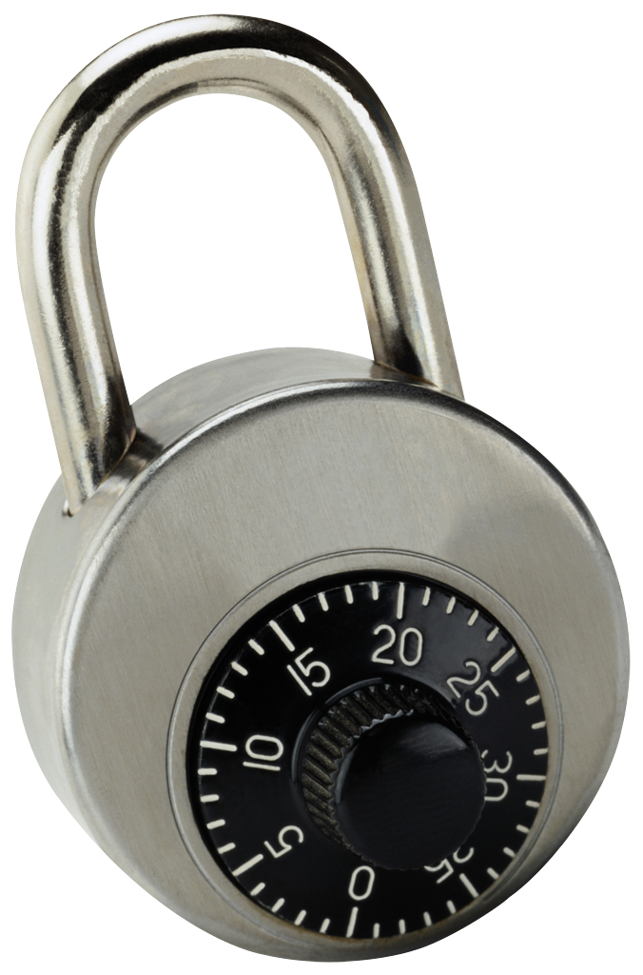
Idea: “encrypt” r using parts of w₀
Gen: - get random combinations of symbols in w₀
r
- “lock” r using these combinations
r
w₀ = a₁ a₂ a₃ a₄ a₅ a₆ a₇ a₈ a₉
Gen
p
r
r
r
r
r
r
r
r
r
r
r
r
a₁ a₉ a₂
a₃ a₉ a₅
a₃ a₄ a₅
a₇ a₅ a₆
a₂ a₈ a₇
a₃ a₅ a₂

Slide 26
Idea: “encrypt” r using parts of w₀
Gen: - get random combinations of symbols in w₀
r
- “lock” r using these combinations
r
w₀ = a₁ a₂ a₃ a₄ a₅ a₆ a₇ a₈ a₉
Gen
p
r
r
r
r
r
r
r
r
r
r
r
r
a₁ a₉ a₂
a₃ a₉ a₅
a₃ a₄ a₅
a₇ a₅ a₆
a₂ a₈ a₇
a₃ a₅ a₂

Slide 27
Idea: “encrypt” r using parts of w₀
Gen: - get random combinations of symbols in w₀
r
- “lock” r using these combinations
r
w₀ = a₁ a₂ a₃ a₄ a₅ a₆ a₇ a₈ a₉
Gen
p
r
r
r
r
r
r
r
r
r
r
r
r
a₁ a₉ a₂
a₃ a₉ a₅
a₃ a₄ a₅
a₇ a₅ a₆
a₂ a₈ a₇
a₃ a₅ a₂

Slide 28
Idea: “encrypt” r using parts of w₀
Gen: - get random combinations of symbols in w₀
r
- “lock” r using these combinations
- = locks + positions of symbols needed to unlock
p
r
w₀ = a₁ a₂ a₃ a₄ a₅ a₆ a₇ a₈ a₉
Gen
p
r
r
r
r
r
r
a₁ a₉ a₂
a₃ a₉ a₅
a₃ a₄ a₅
a₇ a₅ a₆
a₂ a₈ a₇
a₃ a₅ a₂

Slide 29
Idea: “encrypt” r using parts of w₀
Gen: - get random combinations of symbols in w₀
r
- “lock” r using these combinations
- = locks + positions of symbols needed to unlock
p
r
w₀ = a₁ a₂ a₃ a₄ a₅ a₆ a₇ a₈ a₉
Gen
p
r
r
r
r
r
r
a₁ a₉ a₂
a₃ a₉ a₅
a₃ a₄ a₅
a₇ a₅ a₆
a₂ a₈ a₇
a₃ a₅ a₂

Slide 30
Idea: “encrypt” r using parts of w₀
Gen: - get random combinations of symbols in w₀
r
- “lock” r using these combinations
- = locks + positions of symbols needed to unlock
p
p
r
r
r
r
r
r
a₁ a₉ a₂
a₃ a₉ a₅
a₃ a₄ a₅
a₇ a₅ a₆
a₂ a₈ a₇
a₃ a₅ a₂

Slide 31
Idea: “encrypt” r using parts of w₀
Gen: - get random combinations of symbols in w₀
r
- “lock” r using these combinations
- = locks + positions of symbols needed to unlock
p
Rep:
w₁ = a₁ a₂ a₃ a₄ a₅ a₆ a₇ a₈ a₉
r
Rep
p
r
r
r
r
r
r
a₁ a₉ a₂
a₃ a₉ a₅
a₃ a₄ a₅
a₇ a₅ a₆
a₂ a₈ a₇
a₃ a₅ a₂

Slide 32
Idea: “encrypt” r using parts of w₀
Gen: - get random combinations of symbols in w₀
r
- “lock” r using these combinations
- = locks + positions of symbols needed to unlock
p
Rep:
w₁ = a₁ a₂ a₃ a₄ a₅ a₆ a₇ a₈ a₉
r
Rep
p
r
r
r
r
r
r
a₁ a₉ a₂
a₃ a₉ a₅
a₃ a₄ a₅
a₇ a₅ a₆
a₂ a₈ a₇
a₃ a₅ a₂

Slide 33
Idea: “encrypt” r using parts of w₀
Gen: - get random combinations of symbols in w₀
r
- “lock” r using these combinations
- = locks + positions of symbols needed to unlock
p
Rep: Use the symbols of w₁ to open at least one lock
w₁ = a₁ a₂ a₃ a₄ a₅ a₆ a₇ a₈ a₉
r
Rep
p
r
r
r
r
r
r
a₁ a₉ a₂
a₃ a₉ a₅
a₃ a₄ a₅
a₇ a₅ a₆
a₂ a₈ a₇
a₃ a₅ a₂

Slide 34
Idea: “encrypt” r using parts of w₀
Gen: - get random combinations of symbols in w₀
r
- “lock” r using these combinations
- = locks + positions of symbols needed to unlock
p
Rep: Use the symbols of w₁ to open at least one lock
w₁ = a₁ a₂ a₃ a₄ a₅ a₆ a₇ a₈ a₉
r
Rep
p
r
r
r
r
r
r
r
a₁ a₉ a₂
a₃ a₉ a₅
a₃ a₄ a₅
a₇ a₅ a₆
a₂ a₈ a₇
a₃ a₅ a₂

Slide 35
Idea: “encrypt” r using parts of w₀
Gen: - get random combinations of symbols in w₀
r
- “lock” r using these combinations
- = locks + positions of symbols needed to unlock
p
Rep: Use the symbols of w₁ to open at least one lock
Error-tolerance: one combination must unlock with high probability
Security: each combination must have enough entropy
(sampling of symbols must preserve sufficient entropy)
r
r
r
r
r
r
r
a₁ a₉ a₂
a₃ a₉ a₅
a₃ a₄ a₅
a₇ a₅ a₆
a₂ a₈ a₇
a₃ a₅ a₂

Slide 36
How to implement locks?
A lock is the following program:
If input = a₁ a₉ a₂, output r
Else output ⊥
One implementation (R.O. model): lock = r ⊕ H(a₁ a₉ a₂)
r
a₁ a₉ a₂
Ideally: Obfuscate this program
Obfuscation: preserve functionality, hide the program
Obfuscating this specific program called “digital locker”
Notes:
ADS: Say RO construction first? Then say point obfuscation?

Slide 37
Digital Lockers
r
Digital Locker is obfuscation of
If input = a₁ a₉ a₂, output r
Else output ⊥
Equivalent to encryption of r that is secure even multiple times with correlated, weak keys [CanettiKalaiVariaWichs10]
Digital lockers are practical (R.O. or DL-based) [CanettiDakdouk08], [BitanskyCanetti10]
Hides r if input can’t be exhaustively searched (superlogarithmic entropy)
a₁ a₉ a₂

Slide 38
Digital Lockers
r
Digital Locker is obfuscation of
If input = a₁ a₉ a₂, output r
Else output ⊥
Equivalent to encryption of r that is secure even multiple times with correlated and weak keys [CanettiKalaiVariaWichs10]
Digital lockers are practical (R.O. or DL-based) [CanettiDakdouk08], [BitanskyCanetti10]
Hides r if input can’t be exhaustively searched (superlogarithmic entropy)
a₁ a₉ a₂
Q: if you are going to use obfuscation, why bother? Why not just obfuscate the following program for p
If distance between w₀ and the input is less than t, output r
Else output ⊥
A: you can do that [BitanskyCanettiKalaiPaneth14], drawbacks:
except it’s very impractical
very strong assumption
not known to be reusable

Slide 39
How good is this construction?
Handles sources with t > k
For correctness: t < constant fraction of symbols
r
r
r
r
r
r
a₁ a₉ a₂
a₃ a₉ a₅
a₃ a₄ a₅
a₇ a₅ a₆
a₂ a₈ a₇
a₃ a₅ a₂

Slide 40
How good is this construction?
Handles low entropy sources works for super-log k
For correctness: t < constant fraction of symbols
Construction 2:
Supports t = constant fraction but only for really large alphabets
Construction 3:
Similar parameters but info-theoretic security
Constructions are secure for different types of sources
r
r
r
r
r
r
a₁ a₉ a₂
a₃ a₉ a₅
a₃ a₄ a₅
a₇ a₅ a₆
a₂ a₈ a₇
a₃ a₅ a₂
Notes:
ADS: too much text (break it up somehow?)

Slide 41
How good is this construction?
Handles sources with t > k
For correctness: t < constant fraction of symbols
Construction 2:
Supports t= constant fraction but only for really large alphabets
Construction 3:
Similar parameters but info-theoretic security
Why did I tell you about computational construction?
r
r
r
r
r
r
a₁ a₉ a₂
a₃ a₉ a₅
a₃ a₄ a₅
a₇ a₅ a₆
a₂ a₈ a₇
a₃ a₅ a₂
Notes:
ADS: too much text (break it up somehow?)

Slide 42
How good is this construction?
It is reusable!
Same source can be enrolled multiple times with multiple independent services
r
w₀
Gen
p
Secret even given
p, p', p'', r, r''
r'
w₀'
Gen
p'
r''
w₀''
Gen
p''

Slide 43
How good is this construction?
It is reusable!
Same source can be enrolled multiple times with multiple independent services
Follows from composability of obfuscation
In the past: difficult to achieve, because typically new enrollments leak fresh information (our construction leaks no partial information w.h.p.)
Only previous construction [Boyen2004]: all reading must differ by fixed constants (unrealistic)
Our construction: each reading individually must satisfy our conditions

Slide 44
Conclusion
Reusable fuzzy extractor from noisy sources with arbitrary correlation between repeated readings
Three constructions of fuzzy extractors for sources with limited entropy (k < t)
Exploit structure in source
Questions?
r
r
r
r
r
r
r
a₁ a₉ a₂
a₃ a₉ a₅
a₃ a₄ a₅
a₇ a₅ a₆
a₂ a₈ a₇
a₃ a₅ a₂

